Slide 1

https://www.uni-goettingen.de/en/48115.html
UNPLAB-QuGen_Ch-14[GenetCov II] (Genetic Covariance)
Quantitative Genetic modelling of Genetic Similarity between Relatives; continued.
1

Slide 2
Sequential Number: #48
UNPLAB-QuGen_Ch-14[GenetCov II]
Unless I explicitly state otherwise, images and cartoons are created using ChatGPT.
You may use this material free of charge under the terms of the CC BY license. This requires that you provide appropriate attribution to the author:
W. Link, University of Goettingen, Germany.
In a few cases, individual images, photographs, or similar material may be subject to a more restrictive Creative Commons license. Where this applies, it is explicitly indicated, and you must comply with the stated license terms for those items.
Please check the license information carefully before reuse. Responsibility for complying with the applicable license terms rests entirely with you.
2

Slide 3
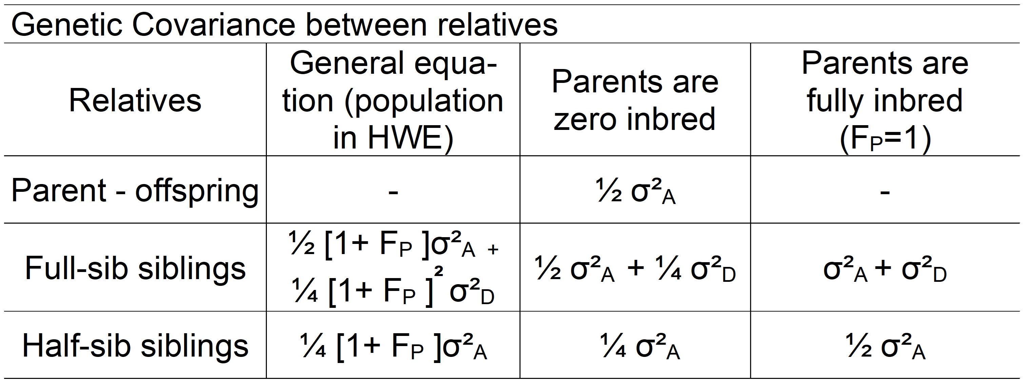
You already know:
Population Genetics (HWE, Inbreeding, Drift, Selection, Equilibrium of Selection and Mutation, Equilibrium of Selection and Drift, Gamete Phase Disequilibrium; the decomposition of the Phenotypic Variance, GxE inlcuding Stability and Breeder‘s Equation; Breeding Methods incl. Heterosis, GCA, Recurrent Selection Schemes, and the Four Categories of Plant Breeding with their Methods; Correlated Traits and Index Selection; The parameters of the Metric Model and of the Statistical Model, the decomposition of the Genetic Variance. Quantitative modelling the Generations F1, F2 and so forth in a Mendelian cross. Kinship f (Coefficient of Coancestry) between relatives such as parent-offspring and siblings; Inbreeding due to crossing such relatives.
Keywords of this chapter: Genetic variance and covariance between and within relatives.
Algebra as introduced
in this chapter:
3

Slide 4
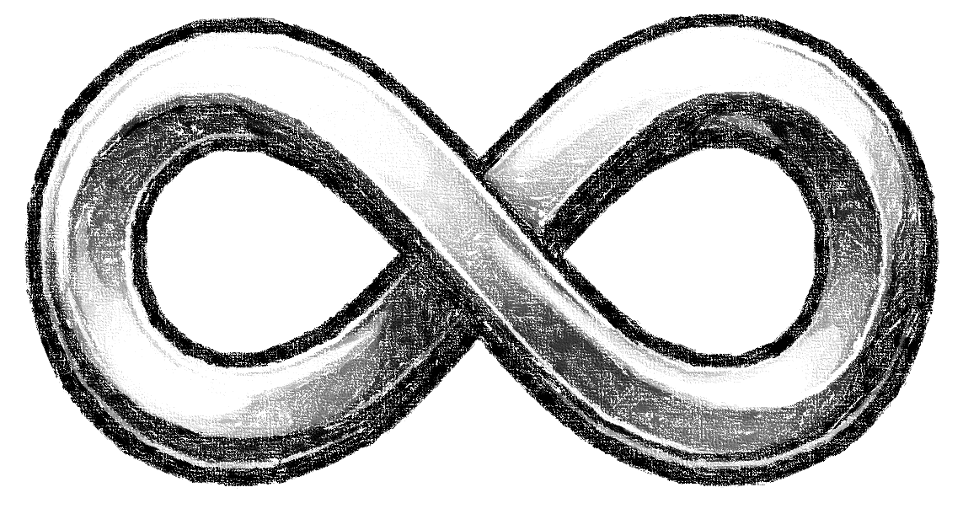
There are of course full-sibs and half-sibs in the HWE-Population; our in our much-plagued and much-quoted Reference Population. This here should visualize it.
N=∞ members of the Population
Take the five drawn parental individuals mating with other five ones as representing endless many which are mated with other endless many gametes ... all is ‘perfect-randomly’.
The size of the families is, as well, not five by five (as drawn) but ∞ by ∞. So: There is no issue with limited sample size and limited representativeness. You have red such statements meanwhile quite often, I know.
Take the diagram to ponder the total amount of genetic variance in the population and how it is subdivided into the variance between (1) the families and the (2) variance within the families.
cf. Schnell, 1982: ‘Synoptic Study’
∙ Gametes
∙ Non-inbred random member of the HWE Reference Population
∙ Random gametes
∙ N=∞ offspring from crossing two random members from the HWE population
N=∞ members of the Population

Slide 5
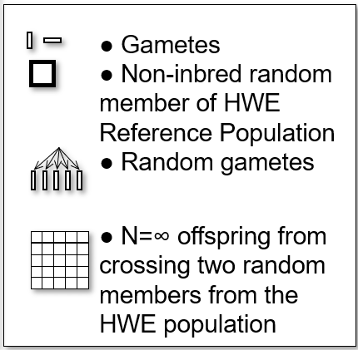
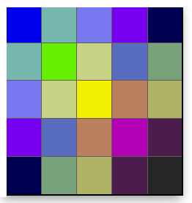


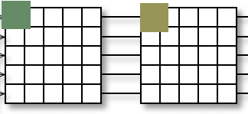



There are of course and indeed full-sibs and half-sibs in the HWE-Population.
This here should visualize it.
N=∞ members of the Population
Our next big endeavour:
We study the (statistical) association between siblings. Imagine: You take many times a random pairs of siblings and thus study their Ø genetic relationship.
N=∞ members of the Population
One pair of two half-sib-siblings
Take N=∞ of them ;-) to study.
One pair of two full-sib-siblings.
Take N=∞ of them ;-) to study.

Slide 6
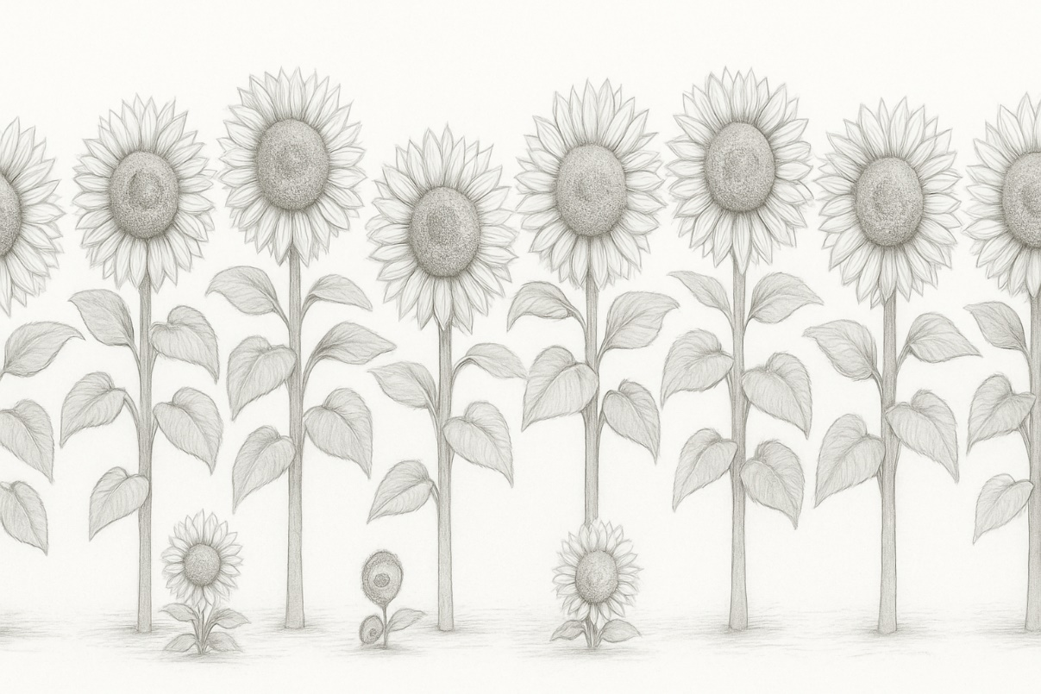
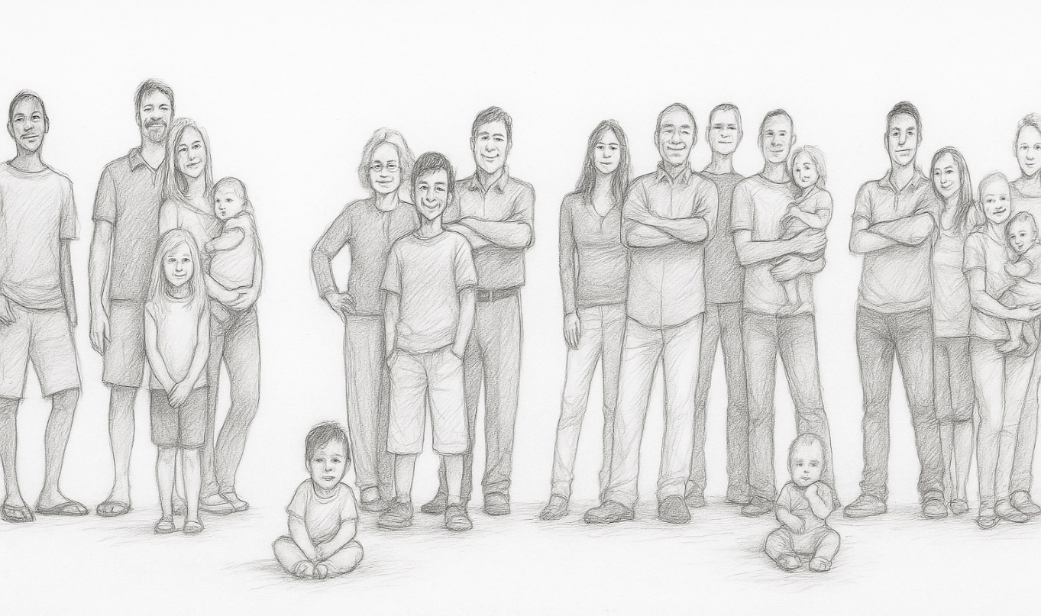
Full-sib siblings ( Full-sibs, FS); Half-sib-siblings (Half-sibs, HS); Parent-offspring.
Starting next page we will come to … genetic ...
Covariance between half-sib siblings within a family, averaged across families
Variance between half-sib siblings within a family, averaged across families
Covariance between full-sib siblings within a family, averaged across families
Variance between full-sib siblings within a family, averaged across families
Covariance between parents and offspring*
*(either one offspring per pair of parents or the mean of ‘all’ offspring per ...)
6
AI-tool was not willing to substitute exactly each sunflower individual by one person, well, stubborn thing it is.

Slide 7
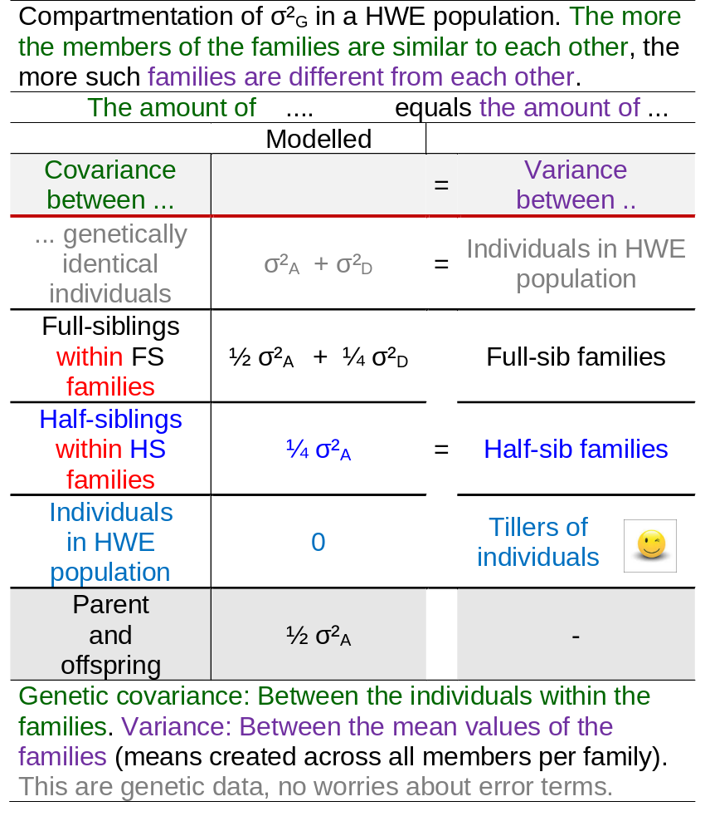
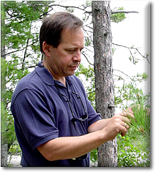
Full-sib siblings ( Full-sibs, FS); Half-sib-siblings (Half-sibs, HS); Parent-offspring; etc.
I am confident that you appreciate that, here, I just give the algebra without deducing (and without proving) it.
cf. Lynch and Walsh, Textbook on Genetics and Analysis of
Quantitative Traits. 1998. Sinauer Asssociates.
cf. Falconer, Textbook on Quantitative Genetics 1983, chapter 9.
Very inspiring source of knowledge and wisdom on Population Genetics and Quantitative genetics:
https://www.e-booksdirectory.com/details.php?ebook=2617
Genetic covariance: Between the individuals within the families. Variance: Between the mean values of the families (means created across all members per family). This are genetic data, no worries about error terms.
Kent E. Holsinger, Connecticut https://scholar.google.com
kent.holinger’at’uconn.edu; http://darwin.eeb.uconn.edu;
CC BY-SA 3.0
7

Slide 8
Try to think ‘Covariance’ in terms of ‘Co-Variance’. Remember: ω_{X∙X} = σ²_{X}
The members of FS families resemble each other more (are more similar to each other; their ω_{FS} = ½ σ²_{A} + ¼ σ²_{D}) than the members of HS families (their ω_{HS} = ¼ σ²_{A}).
FS siblings can be identical for both alleles per locus, the probability is 25% of loci. Therefore, if the genes ‘of’ trait show dominance (d ≠ 0), then such dominance contributes to the genetic variance and, thus, contributes to the genetic co-variance of members of same FS family.
Parent & Offspring share same ‚dose‘ of alleles as full-sibs (50%), yet, without the option to share both-alleles-per-locus. Therefore, Parent-Offspring covariance ω_{PO} = ½ σ²_{A} (without this contribution of ¼ σ²_{D} which we see in the FS case).
Nota bene:
The quantum of covariance within the families equals the quantum of variance between such families. Of course, we talk about expected values and about genetic values and about perfect family means without calamities such as imperfect sampling because of few members per family et cetera. And still, we are in HWE and F=0!
8

Slide 9
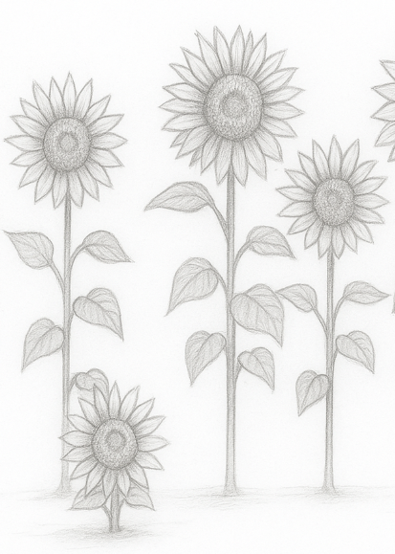
Try to think ‘Co-Variance’ in terms of ‘Variance’.
9
Covariance of individual to itself is maximum ► there is maximum (all) variance between individuals of our HWE population.
Covariance between random members in HWE is zero. Hence, variance ‚inside‘ individuals is zero; forget about schizophrenia or chimeras ... ;-)
There is no entry in the list for „Variance between“ in the case of Parent-Offspring.
Groups of parent-plus-offspring are cross-generational and no longer as easy to (alge-braically) grasped as FS or HS families - which are in same generation.
The small one is of not the kid of a tall one, because they are annual.

Slide 10
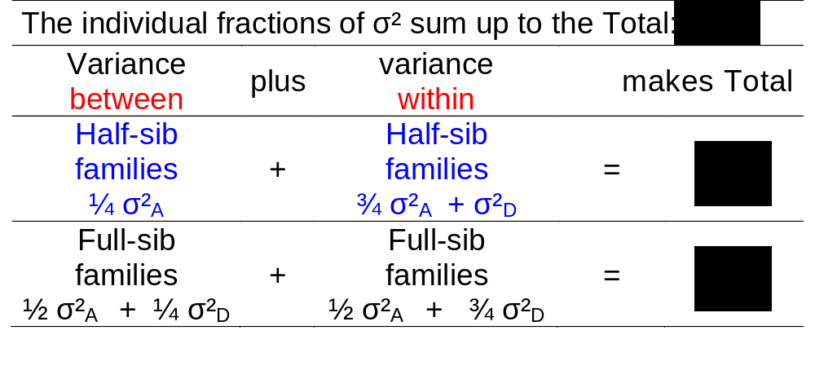
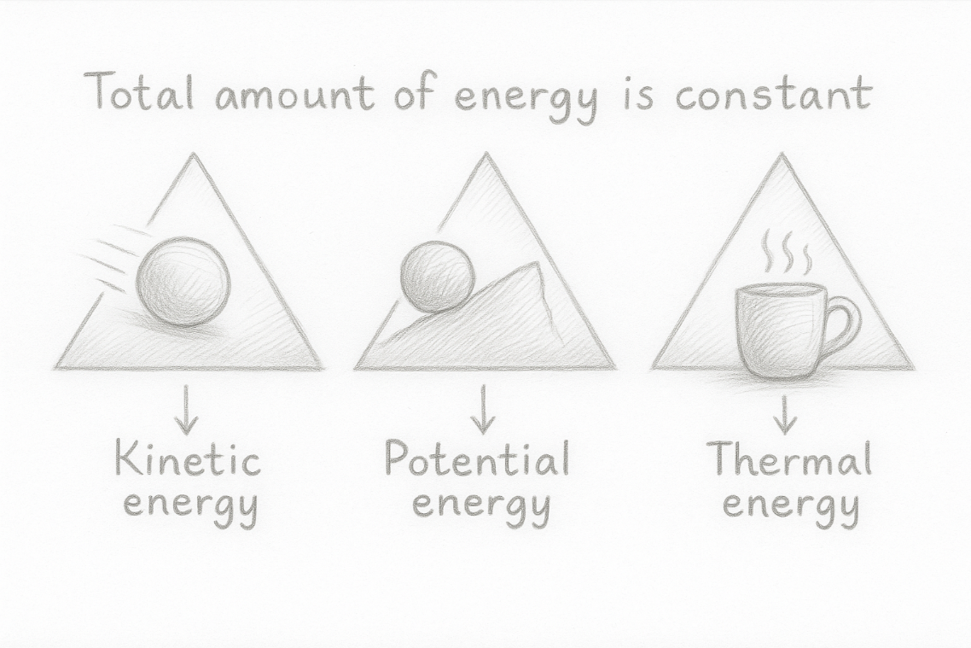
Try to think ‘Co-Variance’ in terms of ‘Variance’.
10
Try the analogy to the 1st law of Thermodynamics: Total amount of energy is constant .. yet there are variants such as kinetic energy, potential energy, thermal energy. Here: Total amount of genetic variance is constant, yet, it may be differentially compartmented. Assumption: No variation in inbreeding (because heterozygosity is a source of additional variance - released in case of inbreeding).

Slide 11
Try to think ‘Co-Variance’ in terms of ‘Variance’.
Between
Within
Total amount of genetic variance is constant, yet, it may be differentially compartmented. The less genetic variance we see within the selection candidates, the more we have between them.
Assumption: No variation in inbreeding (because heterozygosity is a source of additional variance - released in case of inbreeding).
The next page contains some practical application. We take two randomly selected siblings per family, phenotype one and reproduce the other. The reproduced sibling is used as a representative (replacement) for the phenotyped sibling.
11

Slide 12
Take many random individuals from our Population: Variance between them is σ²_{G}.
Take 1 offspring from each of many random families: Variance between them is σ²_{G}.
Take again 1 (another one) offspring from each of many rand. fam.: Variance is σ²_{G}.
We discuss genetic variance and covariance, hence, we discuss true, genetic data. Data does not contain GxE nor error nor mistake.
E.g.
r = 0.80
R²=0.64
These two blue dots would symbolize such ‘one and the other’ sib-ling. They are both taken as offspring from the same random pair of parents* taken from the population, this is, they are both taken from
the same random family. You see the other pairs of dots, each pair with one red point in the scatter graph.
The variance on the x-axis would be σ²_{G}, the variance between random individuals (each one represents its family).
The variance on the y-axis would again be σ²_{G}, the variance between random individuals (each one represents its family).
Dou you agree that, genuinely, on both axis we see the variance between random members of the population, hence, the variance on both axes is expectedly the same and it is indeed σ²_{G}?
12
Performance of the other-out-of two siblings
Performance of the-one-out-of two siblings
*wording is for are full-sib families. Could be half-sib families, too.

Slide 13
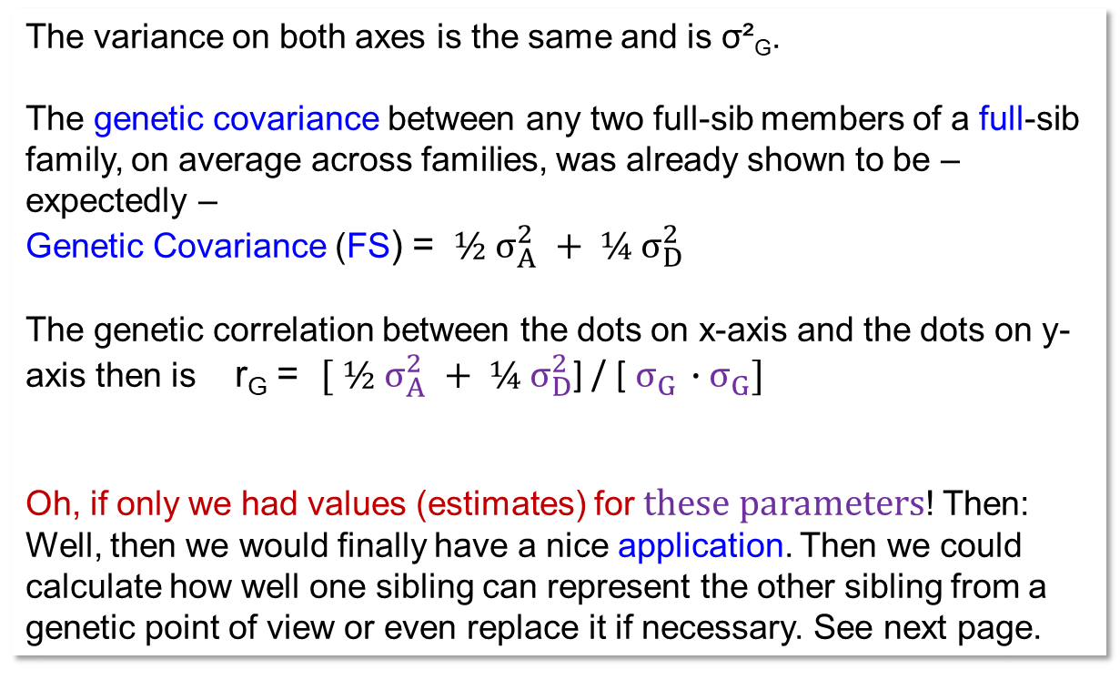
We study the genetic relationship between full-sib siblings, across very many families.
E.g.
r = 0.80
R²=0.64
The variance on both axes is the same and is σ²_{G}.
The genetic covariance between any two full-sib members of a full-sib family, on average across families, was already shown to be – expectedly –
Genetic Covariance (FS) = ${ ½ σ}_{A}^{2}{ + ¼ σ}_{D}^{2}$
The genetic correlation between the dots on x-axis and the dots on y-axis then is r_{G} = ${[ ½ σ}_{A}^{2}{ + ¼ σ}_{D}^{2}$] / [${ σ}_{G }∙{ σ}_{G}]$
Oh, if only we had values (estimates) for these parameters! Then: Well, then we would finally have a nice application. Then we could calculate how well one sibling can represent the other sibling from a genetic point of view or even replace it if necessary. See next page.
Performance of the other-out-of two siblings
Performance of the-one-out-of two siblings
Why should we use one sibling to substitute the other one?
In Animal Breeding: Use sisters of cockerels to measure egg laying traits; correspondingly in monoecious plants such as Asparagus, hemp, kiwifruit. And generally such ‘substitution’ occurs if we must destroy a plant or the seed harvested from a plant to assess trait expression (e.g. resistance test, seed quality assessment).

Slide 14
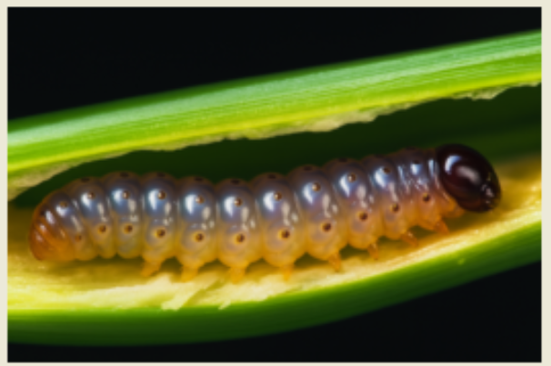
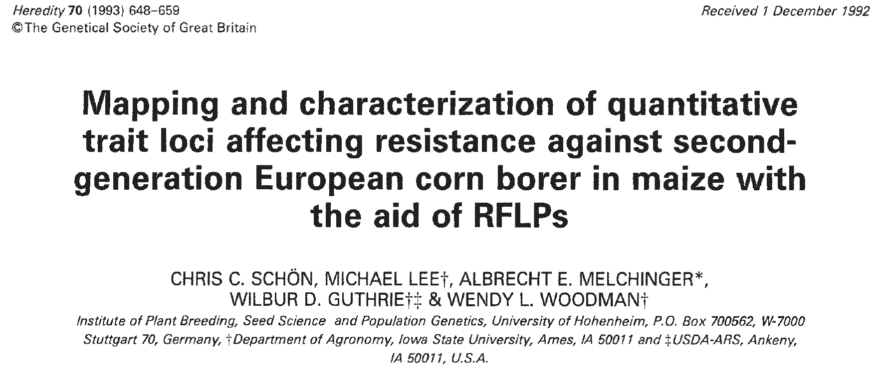
“Oh, if only we had values (estimates) for these parameters”.
A little practice and application, a rehearsal, a rest break.
Data from the corn borer example.
Assume a Hardy-Weinberg-Equilibrium population, maize.
Trait is eating-tunnel-length in stalk.
σ²_{A} = 36.06 cm²; σ²_{D} = 9.530 cm²; σ²_{G} = 45.59cm².
Calculate the genetic correlation coefficient for this trait for (1) any two members of typical half-sib families; for (2) any two members of a typical full-sib family.
You know: In general, correlation coefficient r = cov_{x∙y}/(σ_{x} σ_{y}).
(1)
Correlation coefficient r between HS = cov_{HS}/(σ_{G} ∙ σ_{G}).
The variance on the X-axis and the Y-axis is σ²_{G} . A nice, almost funny insight.
Correlation coefficient r between HS = ¼ σ²_{A} / σ²_{G} = 9.015/ 45.59 = 0.198. The coefficient of determination, hence, R² = r² = 0.0391 says: ‘About 4% of the genetic variance between the first-picked half-sib siblings is explained by their linear regression onto the genetic values of the second-picked half-sibs of their respective family’. That is little.
(2) r between FS = (½ σ²_{A} + ¼ σ²_{D}) / σ²_{G} = 20.413/ 45.59 = 0.448; hence, R² = 0.200 ... this is markedly more, this is more than double, and you see why! FS represent each other much better than HS. They share both parents.
14

Slide 15
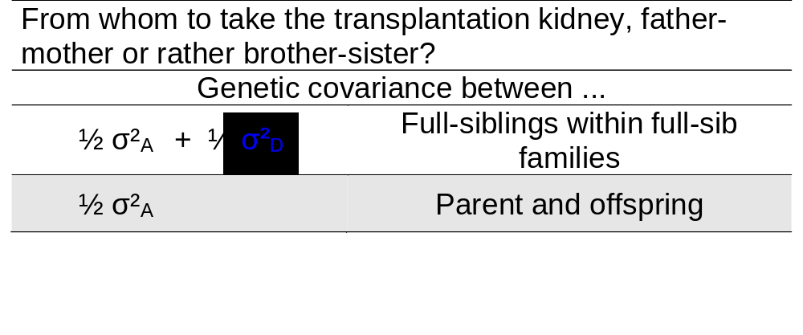
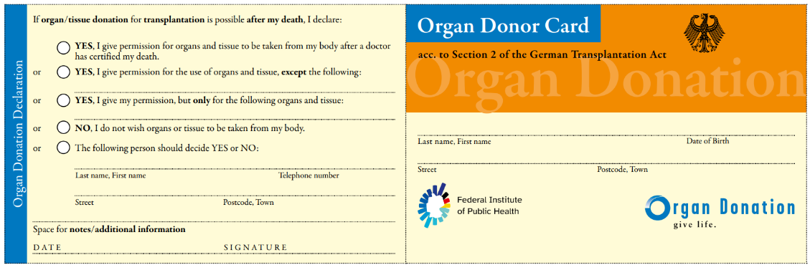
By the way. What now is your response to the kidney (transplantation) issue?
Your mother-father or rather your brother-sister? Both share 50% of genes with you.
Kidney shape
I have, sorry, no clue about the human genetic factors which are relevant for kidney transplantation; immune system factors and the like (leukocyte antigen antibody factors). Yet, whatever the genetic traits and features are which are important, if there is dominance involved in the genetic variation of these features, then a full-sib sibling‘s kidney will be more similar and thus probably be better suited. If dominance is not involved, then parents and full-sib
have the same generally expected similarity.
The best donor is anyway an identical twin.
Better are only the person‘s own (intact) kidneys. ☺
www.organspende-info.de
15

Slide 16
For our parents and families, we now add one layer of complexity.
We set aside the notion of
● “Everybody including the parents of the families is non-inbred”
and accept the option that
● “The parents of the families may be more or less inbred; 0 < F_{P} < 1”.
We continue to maintain the simplifying assumption that these parents are
not related to each other ...
and this - of course - means that the offspring of these more-or-less inbred
parents are not inbred (and this is the sense of keeping parents non-related)
16

Slide 17
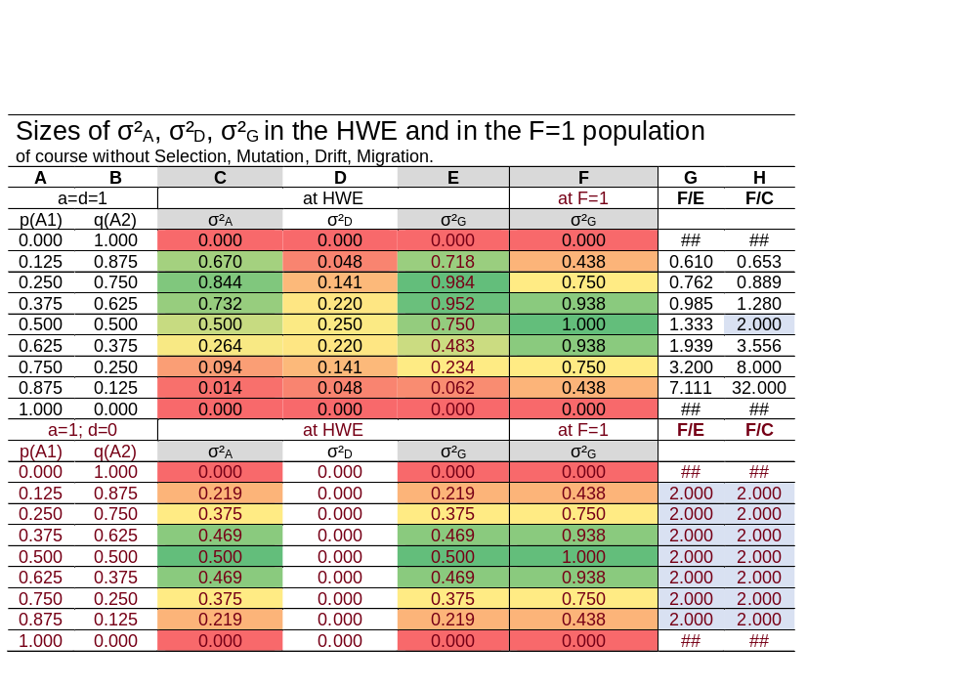
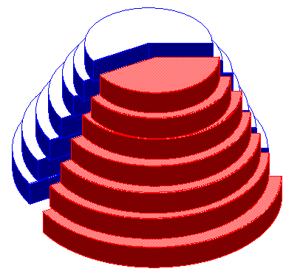
Note that Variance of Breeding Values σ²_{A} and Genetic Variance σ²_{G} in our HWE Refe-rence population is mostly smaller than if the population was inbred to F=1 (without SelMutMigDrift). See impact of p(A1) ... and of either a=d=1 or a=1 but d=0.
Well, mainly for the ones who want to really understand such details ... ... Just employ your own EXCEL and reconstruct the table ;-)
And, again, this detail:
With a=1=d and given p(A1) = 0.292893 we find, at HWE, σ²_{G} =1.00 ;-)
17

Slide 18
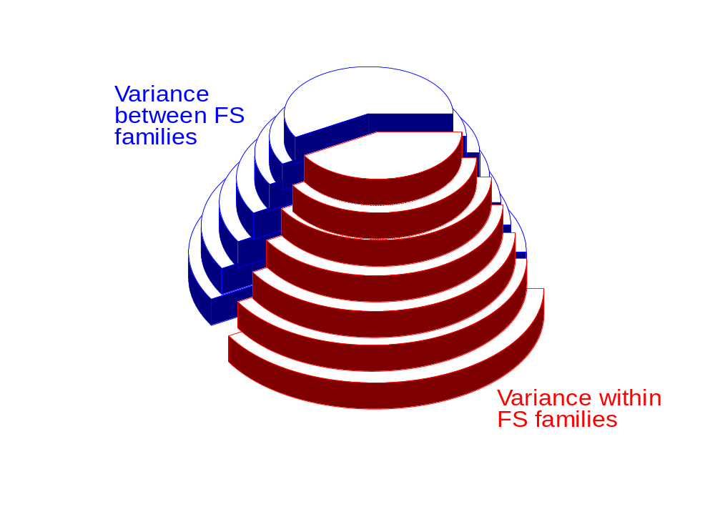
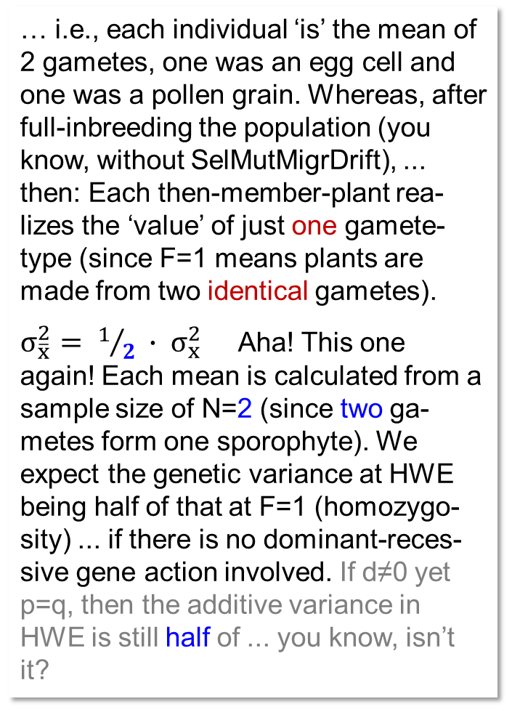
Inbreeding creates a ‘third dimension’! Why is this? Well ... neglecting dominance, each population member realises the genetic mean of the two gametes that produced it ...
… i.e., each individual ‘is’ the mean of 2 gametes, one was an egg cell and one was a pollen grain. Whereas, after full-inbreeding the population (you know, without SelMutMigrDrift), ... then: Each then-member-plant rea-lizes the ‘value’ of just one gamete-type (since F=1 means plants are made from two identical gametes).
$σ_{\overline{x}}^{2}= 1/2 ∙ σ_{x}^{2}$ Aha! This one again! Each mean is calculated from a sample size of N=2 (since two ga-metes form one sporophyte). We expect the genetic variance at HWE being half of that at F=1 (homozygo-sity) ... if there is no dominant-reces-sive gene action involved. If d≠0 yet p=q, then the additive variance in HWE is still half of ... you know, isn’t it?
Variance between families
Increased Inbreeding
Variance within families
18
Inbreeding ‚releases‘ additional genetic variance compared to HWE. Actual proportions ‚between‘ versus ‚within‘ and impact of inbreeding on the ratio depend on number and frequency of alleles and on dominance and epistasis.

Slide 19
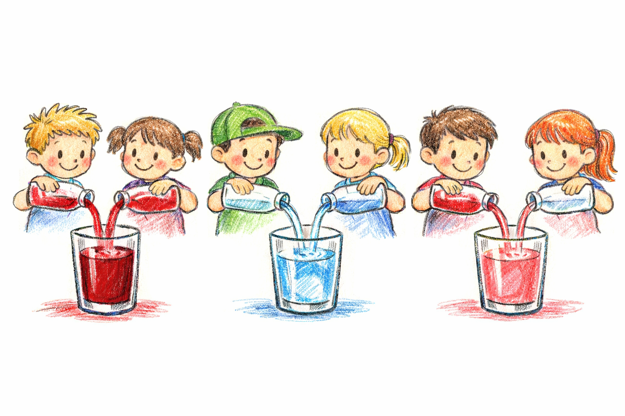

$σ_{\overline{x}}^{2}= 1/2 ∙ σ_{x}^{2}$ if the means were created from N=2 (2 gametes make 1 individual)
The union of the genetic information of two ga-metes can create a mix-ture, but in contrast, it can also preserve and maintain purity and com-plete contrast: Namely, if the two gametes contain the same information.
Symbolised by ...
the union of the contents of two bottles does not lead to mixing: Namely, if the bottles have the
same contents.
And, of course, mixtures are generally expected to correspond to the mean value of their components. And, as mentioned earlier, mean values are closer to the general mean than individual (pure, unmixed) values. This is obvious: The largest and smallest values, for example, can no longer be ‘extreme’ after being ‘mixed’ with some other value.
19

Slide 20

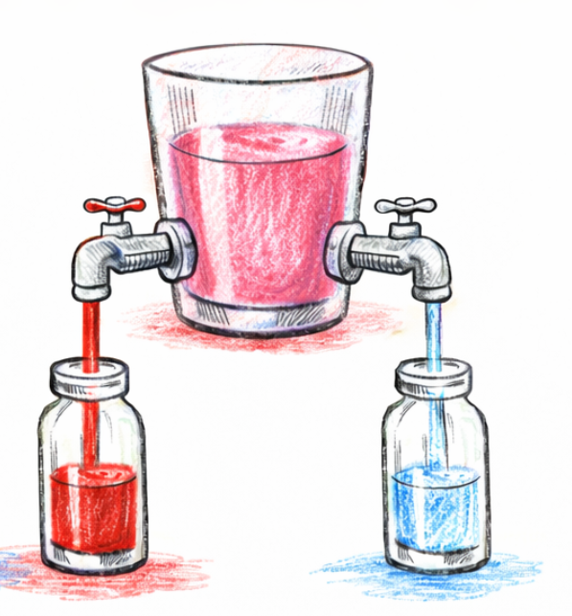
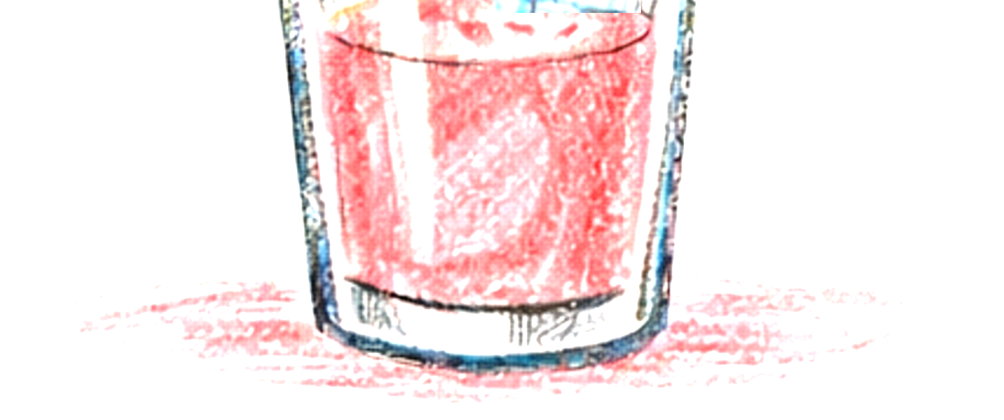
By the way and as we are at it here: Darwin understood the left picture: Mating two different parents leads to somewhat intermediate offspring. But only Mendel solved the riddle of the right pictures: How is it possible that after ‘things’ are mixed, the initial features appear separated again at the bottom? This is, admittedly, contra-intuitive and was a great finding.
20

Slide 21
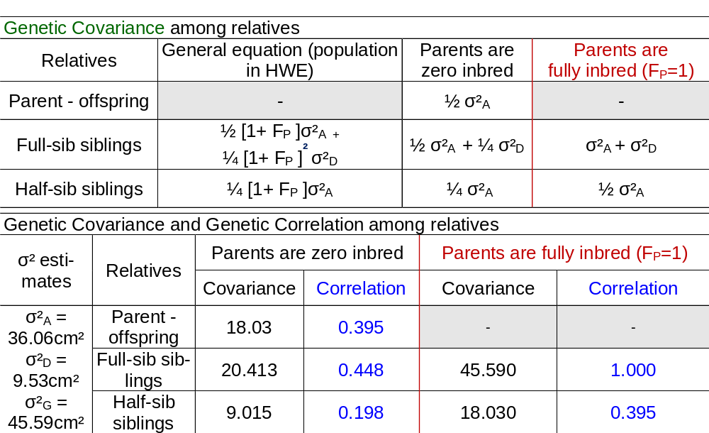
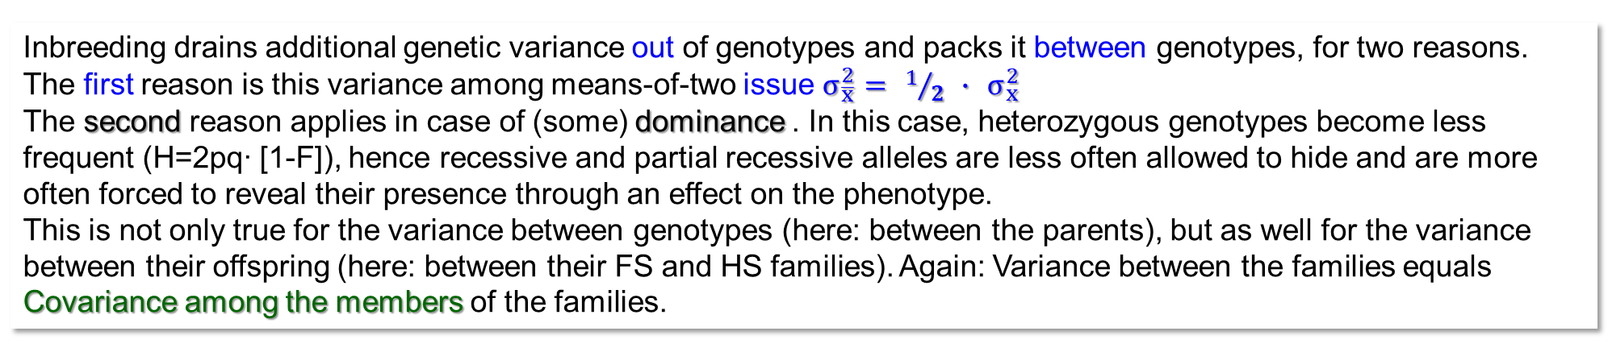
Genetic covariance between relatives, parents being 0 < F_{P} < 1 (anyway non-related). Quantified and decomposed according to Quantitative Genetic Variance components
Inbreeding drains additional genetic variance out of genotypes and packs it between genotypes, for two reasons.
The first reason is this variance among means-of-two issue $σ_{\overline{x}}^{2}= 1/2 ∙ σ_{x}^{2}$
The second reason applies in case of (some) dominance . In this case, heterozygous genotypes become less frequent (H=2pq∙ [1-F]), hence recessive and partial recessive alleles are less often allowed to hide and are more often forced to reveal their presence through an effect on the phenotype.
This is not only true for the variance between genotypes (here: between the parents), but as well for the variance between their offspring (here: between their FS and HS families). Again: Variance between the families equals Covariance among the members of the families.
21

Slide 22
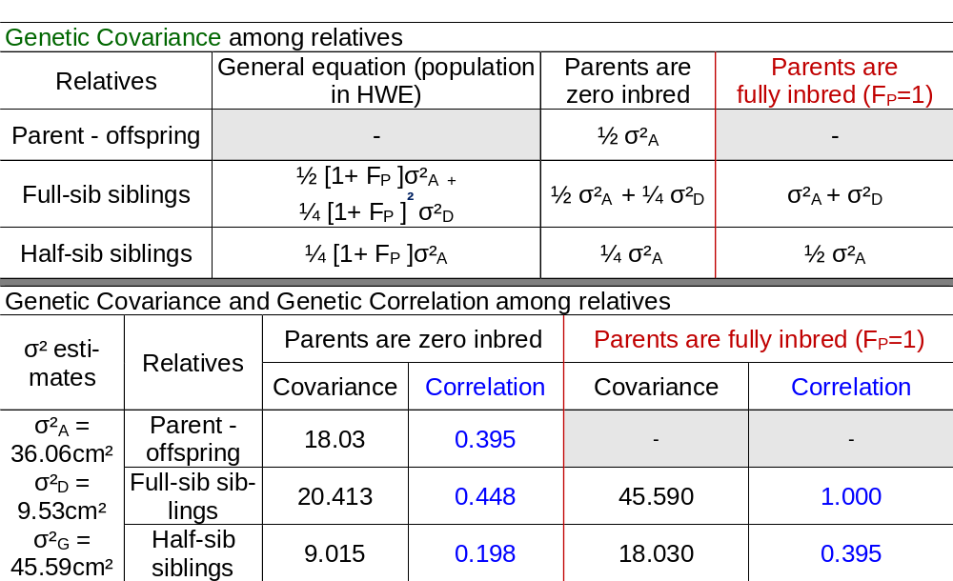
Genetic covariance among relatives, parents being 0 < F_{P} < 1 (anyway non-related). Quantified and decomposed according to Quantitative Genetic Variance components
For example: r=0.395
= 18.03 / (45.59^{0.5} ∙ 45.59^{0.5})
I don't know about you; but the non-normalised figures for covariances tell me little; in contrast to this, a correlation coefficient -1 ≤ r ≤ +1 tells me a lot. Hence, see the genetic correlations between relatives.
The correlation of r=1.000 is of course the result of crossing homozygous parents and comparing their FS offspring; these are, in that Mendelian situation, all ‚same‘ (Mendel’s first law, Principle of Uniformity). Here, r=1 because ω_{G} is as large as σ²_{G}.
Parent-offspring: With homozygous parents, the variances don’t not apply for the parent generation.
Parental homozygosity would lead to zero σ²_{D} yet probably to higher σ²_{G} in that generation; therefore, the equations do not hold for the case of parent-offspring with inbred parents (albeit parents still unrelated, f_{P} =0).
22

Slide 23
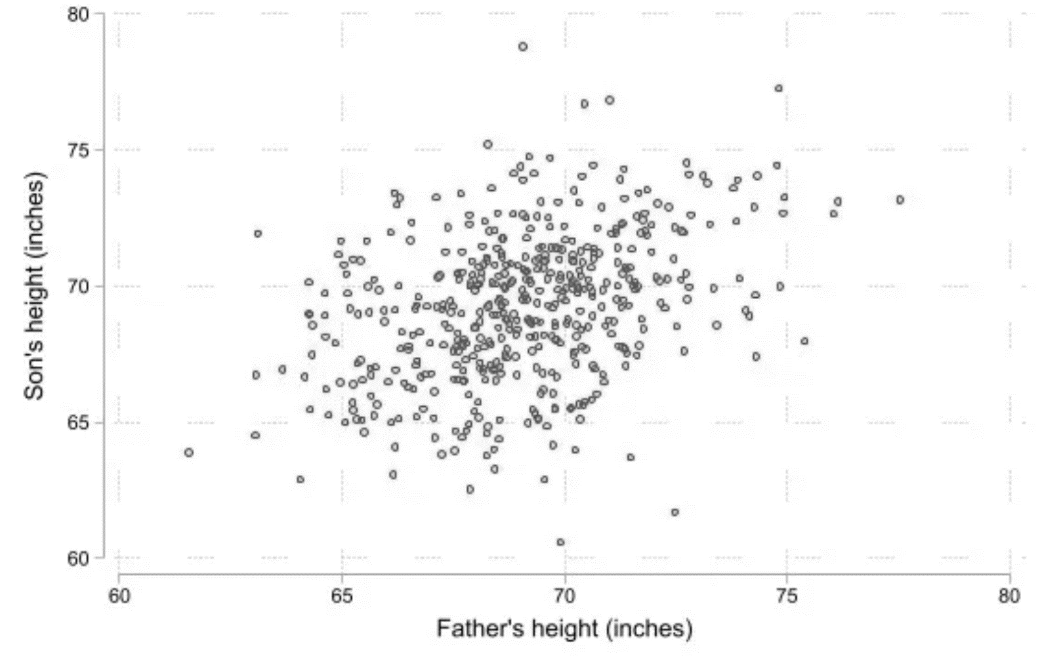
Francis Galton (1886). Regression towards mediocrity in hereditary stature. The Journal of the Anthropological Institute of Great Britain and Ireland. 15: 246–263.
Regression line.
Son’s height and father’s height. Galton’s original data (N=481).
Tall fathers tend to have taller-than average offspring. Due to environment and mothers’ impact, fathers effects are not fully translated into sons’ effects.
The points of sons that have the same height as their fathers lie on the diagonal (on the bisector). However, the further we move away from the mean value, the more the points lie above (left part of x-axis) or below (right part 6 > 2).
80
75
70
65
60
Sons are phenotypically similar to fathers for their body height.
2 above fathers’ mean
Son‘s height (in inches)
Regression line
6 below fathers’ mean
Angle bisector, diagonal
45°
60 65 70 75 80
Father‘s height (in inches)
23

Slide 24
Parent-Offspring: Offspring are individuals. Dominance Variance is small in this example.
Many individual offspring per parental genotypic value
Relatives to be compared | Parents are not inbred
Parent (N=1) vs. offspring (N=1) | ω_{PO} ≈ ½ σ²_{A}
 | b_{PO} ≈ ½ r_{PO} ≈ ½
P means parent, it does not mean phenotypic value. We deal here with genetic data.
genotypic
Regression line
Daughter's genotypic value
Note that genetic regression and genetic correlation are identical. This is because genetic variance σ²_{G} between mothers (previous generation of the population) matches the genetic variance between daughters (current generation of the population).
Mother's genotypic value
It goes without saying: The number of dots per each mother-genotype value is N=∞. Even if for example only two daughters are shown per mother-value, they are meant to be very many and to be a perfect sample of the N=∞ possible daughters that theoretically could exist.
24

Slide 25
Parent-offspring: Offspring individuals or Offspring-family means?
25
Many individual offspring per parent
Mean of many offspring per parent
Relatives to be compared | Parents are not inbred
Parent (N=1) vs. offspring (N=1) | ω_{PO} ≈ ½ σ²_{A}
 | b_{PO} ≈ ½ r_{PO} ≈ ½
Parent (N=1) vs. offspring (N=∞) | ω_{PO} ≈ ½ σ²_{A}
 | b_{PO} ≈ ½ r_{PO} ≈ 1
genotypic
Daughter's genotypic value
See that regression and correlation are not same. Regression b_{PO} ≈ ½.
Mother's genotypic value
b_{PO} ≠ r_{PO}. This is because the variance from segregation inside each HS-family of daughters per mother is missing; a HS family mean was formed (per family) from a very large number of daughters per mother. Without dominance (and without epistasis), mothers‘ genotypic values and their HS-daughters’ means are perfectly and linearly connected.

Slide 26
Parent-offspring (still Random Mating): Offspring individuals or Offspring-family means?
Many individual offspring per parent
26
Some random mother-offspring pairs
● Correlation should be r ≈ 0.5; and as well Regression should be b ≈ 0.5.
Yet, in an true-world sample of mother-daughter pairs, r and b depend very much on the actual sample of mother and offspring individuals (we still deal with Genetic data; no error no GxE).
The regression as estimate of h² is, here, ~ h²=0.5 (maximum-possible value): (1) because we neglect dominance (and epistatic) variation and (2) because we deal with genotypic data instead of phenotypic data. Otherwise we expect here h²<0.5
genotypic
Daughter's genotypic value
Again: We do in reality not know neither mother's genotypic value nor daughter’s genotypic value.
We have seen earlier that the correlation coefficient between phenotypic data of a set of genotypes, ...
Mother's genotypic value
genotypic
... taken from one experiment and from another experiment (each in an environment from the target pool of envs.) ... ... such correlation estimates h² of such experiment (h² _{Broad Sense} since same genotypes on both axes).
The phenotypic correlation between daughters and mothers (dominance neglected) would estimate ½ h², and it would be ½ h²_{Narrow Sense}; of course. ► h²_{Narrow Sense}, defined as ratio σ²_{A} / σ²_{P}

Slide 27
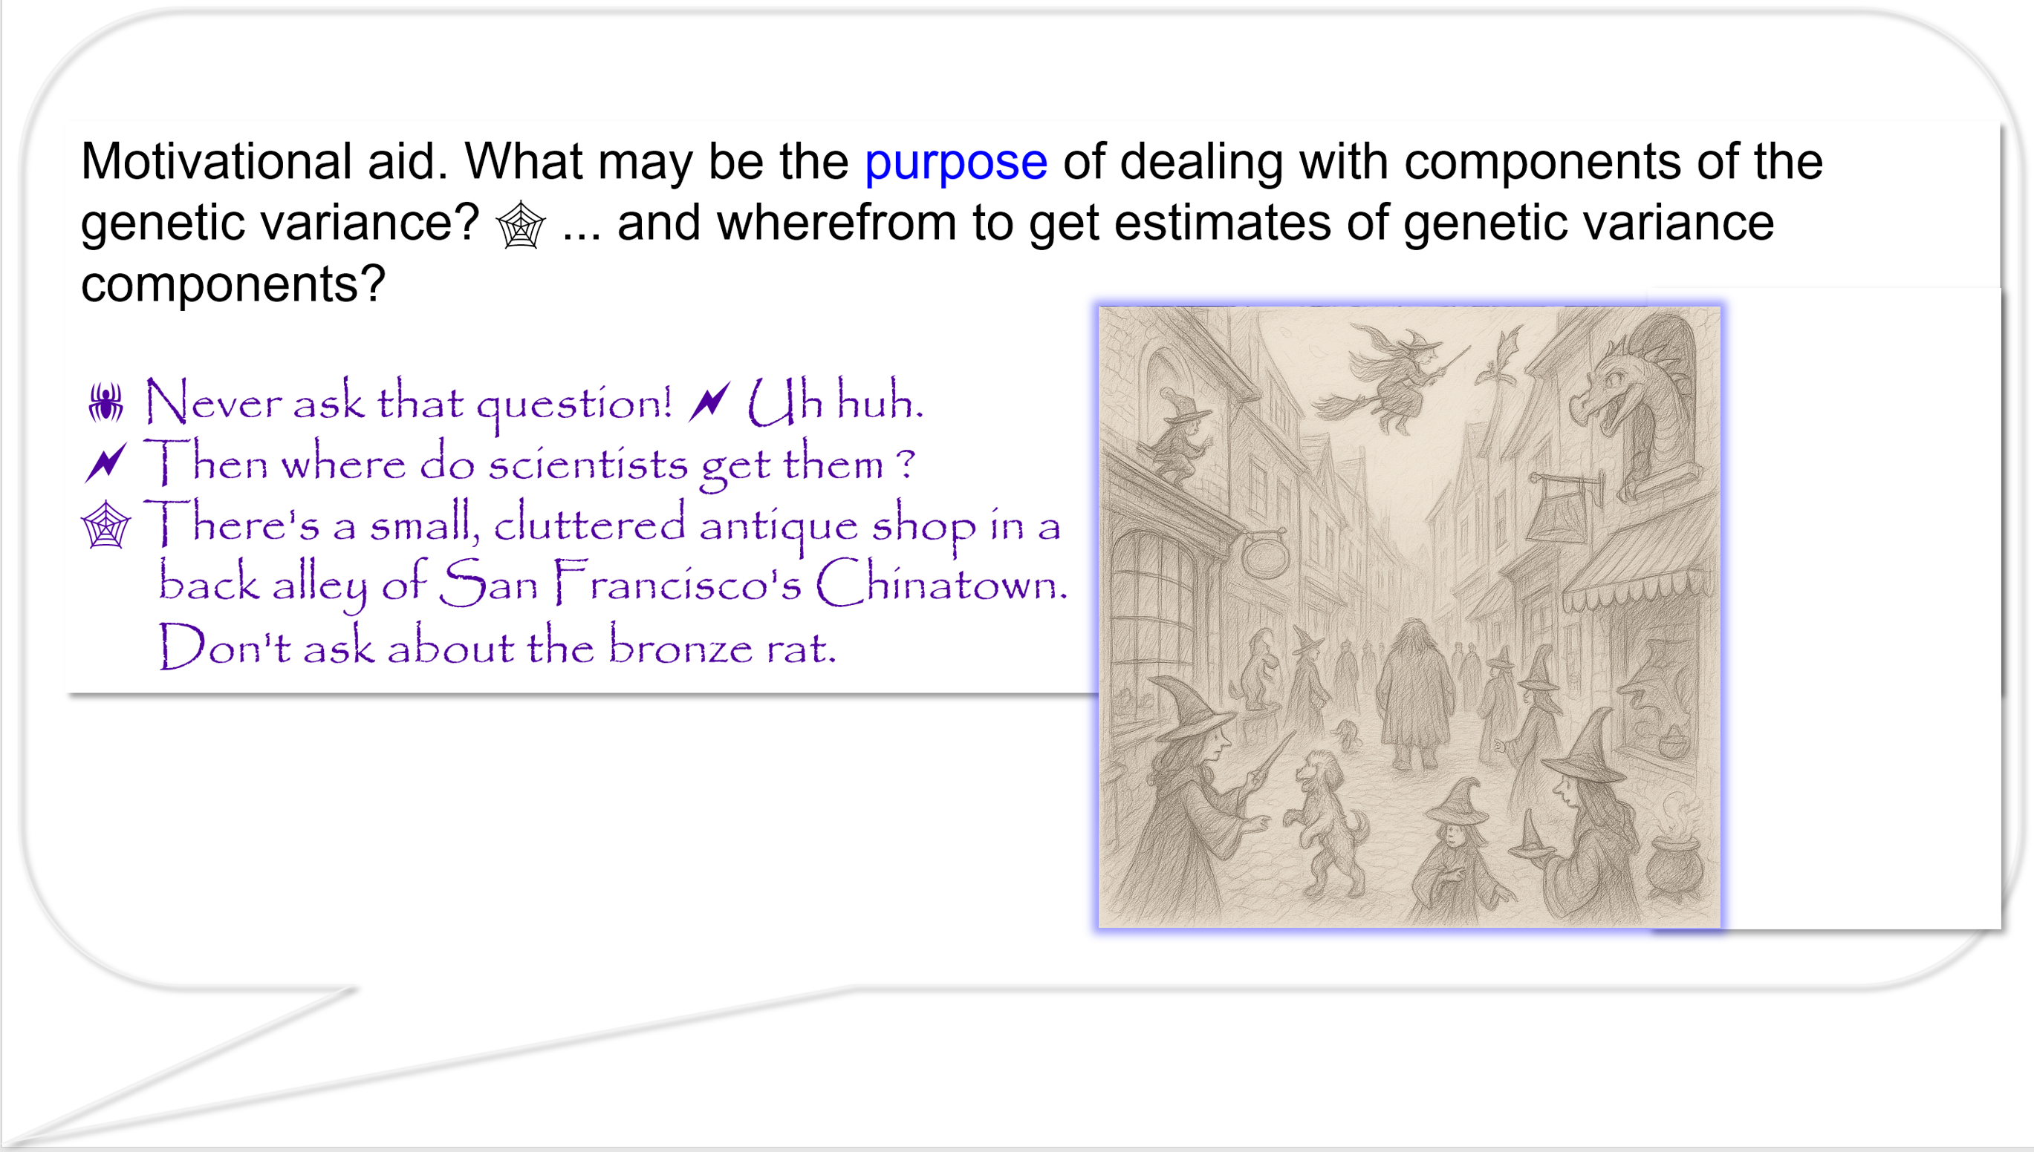
You may jump to page 35 without missing the connection
27

Slide 28
DOI: 10.1038/s41437-020-0312-1
Variance components have at least two sides.
They are used to describe (model, ‘understand’)
(1) phenotypic or genotypic variance of candidates (2) kinship between candidates.
Unless we do not want to utterly invent them, then we have to estimate them from experimental data. We usually have to accept strong (spooky) assumption on randomness and representativeness of genotypes, locations, sites, agronomic treatments etc.; and on samples to be sufficiently large and well-taken from the Basic Pool. And on random vs. fixed effects, on whether interaction effects ‘random x fixed’ are random or fixed; on degrees of freedom and on what-the-heck is the appropriate error term. Estimating V.cps. is a bit like a job for a team of grey eminence and secret service ... a semi-philosophical endeavour, imho.
You remember the difference between estimation and guessing, do you?
28

Slide 29
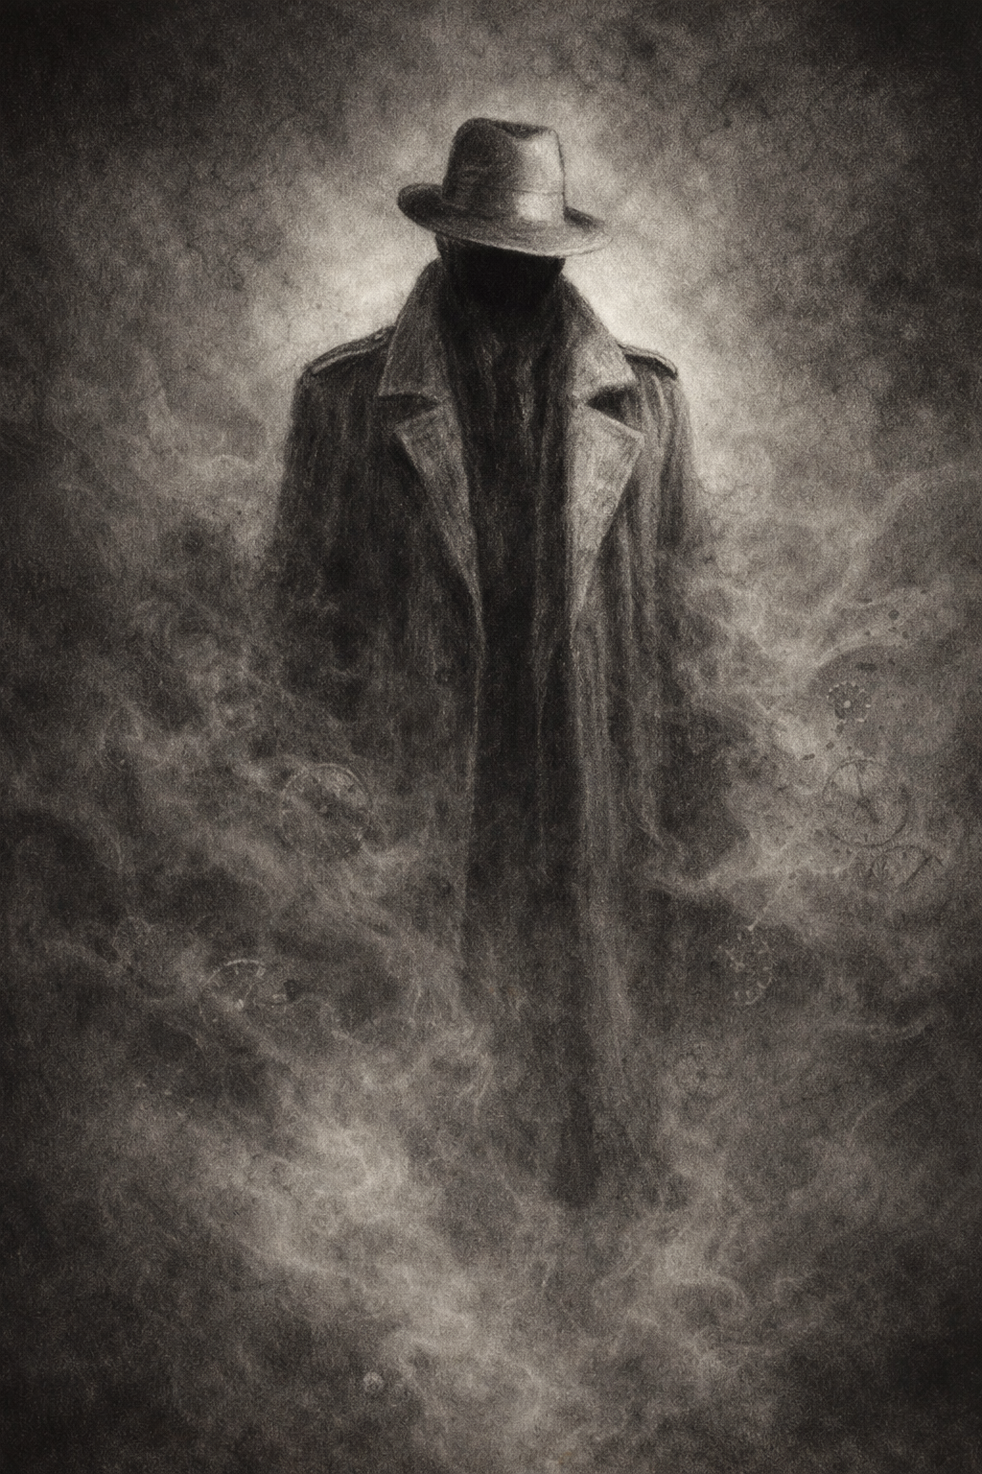
The purpos(es) of estimating and using variance components - to some it seems a weirdish secret. If you are embarking in a new crop species or in a new trait, you may want to quantify the available genetic variance to forecast potential gain from selec-tion. You may want to study mode of gene action (interme-diate, dominant; impact of heterosis) to choose the adequate Category of Breeding (Population Breeding, Hybrid Breeding).
Secret, grey eminence.
With ChatGPT
You may want to improve Allocation of your € $ £ ¥ (e.g. number and location of test environments). You may want to analyse correlations between traits (to use a Selection Index), you may need to distinguish between genetic and environmental variance of traits and covariance between traits. For all this, you may need them.
‘Grey Eminence’
Yet.
In advanced breeding programs, actual breeding is mostly in time and money trouble and focussed on day-to-day issues and less inclined to ask for the promised aid from employing estimates of variance components. Especially plant breeders of self-fertilizing crops are reluctant in this respect (for reasons that you ... see? don’t see?).
Classical, phenotype-pedigree based approach to variance components and gene action J. Plant Breed. Genet. 01 (03) 2013. 117-129
Modern, phenotype plus DNA-marker based approach to genetic variance, gene action, gene effects. DOI 10.1038/s41437-020-0336-6
29

Slide 30
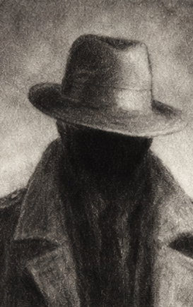
Anyway (cf. Rex Bernardo, 2020. Heredity 125, 375-385. Instructive!).
Anyway,
precision and ‘truth’ of estimates of variances is typically low. Advanced breeders follow good rules of
thumb, they ‘anyway’ cross elite x elite and prefer to cross unrelated parents. They ‘anyway’ test at
informative environments and rather employ more environments instead of more replicates per env.
Anyway: Without using V.cps. to steer their
work onto the right track. They use DNA marker data to monitor genetic distances, to predict heterosis and Genetic or Breeding Values. Breeders support such prediction from data of ongoing work. Some do not invest too much in Recurrent Selection (where estimates of V.cps. are helpful) but focus in direct Cultivar Development. Breeders of self-fertilizing crops are less inclined to follow a “Mating Design” such as Diallel or MAGIC – being precondition to academically estimate Var.cps. Breeders may obtain estimates or guide values on genetic variances, on gene action, on allele effects as an integral part of their breeding activities. Modern approaches (Genomic Selection) allow a more direct exploitation of breeders’ germplasm instead of constructing academic panels of genotypes for this.
Main, classical steps and approaches to acquire estimates of genetic variances and variance components:
● Progeny testing (e.g. half sibs, full sibs, topcross-progenies, bi-parental inbreds such as DH- or RIL-families).
● Evaluation of such progenies across a set of environments (representative locations in representative years).
● Estimate variances via ANOVA and equate (gleichsetzen) them with their expectations based on
Quantitative-Genetic models.
For this, usually you hypothesize that relatives are non-inbred and came from a particular Reference Population which is in HWE and LD≈0. Thus, such estimates apply to that population, i.e. the parents used for crossing (Diallel) cannot be ‘chosen-by-intent’ but should be ‘picked-at-random’, and should commonly belong to one population.
This restriction makes genetic variances especially attractive for animal and forest breeders, since they more typically work with long-lived populations and races.
30

Slide 31
Are you interested in the actual genotypes themselves
or
are they merely a representative sample of your target material?
Cf. so-called “Fixed Effects vs. Random Effects”
Fixed effects (Fixierte Effekte, feste Effekte)
You are interested in the differences between your genotypes aka effects of the genotypes per se; the tested material is the material in what your are actually interested in. Thus, the sum of the genetic effects is zero Σt_{i}=0.
Random effects: The experimental genotypes are (only) a restricted yet random, representative sample from a larger Reference Population (Universe of Genotypes; Basic Pool; Grundgesamtheit). In this Universe of Genotypes, the genotypic effects have a mean of 0 and genetic variance of σ²_{G}. Your objective is to extend experimental findings (conclusions) from your sample to (all members of) this Reference Population. Since your experimental sample is not exhaustive, you must expect that Σt_{i} ≠ 0 for any actual experiment.
Assuming genotypes as fixed, F-test in ANOVA is typically using the plot-error variance as error term to test variance between genotypes for significance.
Assuming genotypes as random, F-test in ANOVA is typically using the GxE interaction variance as error term.
Heritability (repeatability) tends to be lower in ‘random’, reflecting the fact that you ask more ‘power’ from the data (extrapolation, extension of conclusion).
31

Slide 32
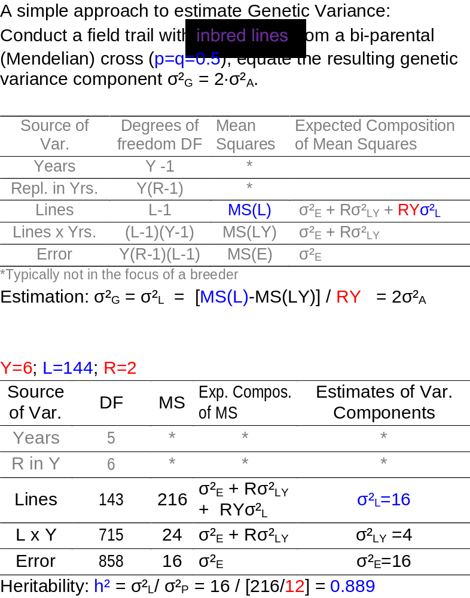
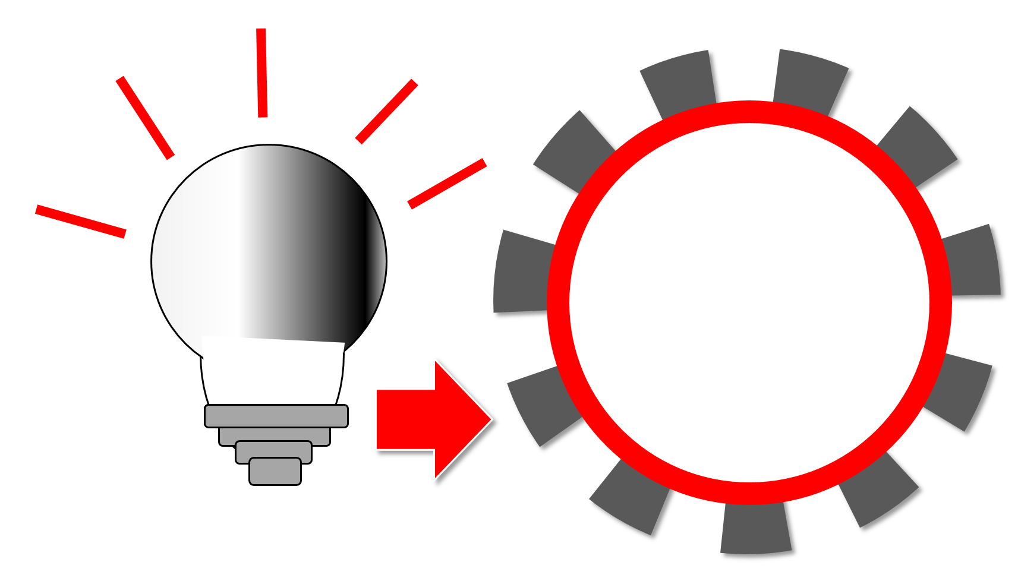
How to estimate genetic variance based on phenotype, via ANOVA (Analysis of Variance); without DNA markers.
You see a discrepancy between our earlier mantra-like, repeated statement of ‚all being non-inbred and non-related etc.‘ and the advice here to take inbred lines (RILs, thus lines from a single-seed-descent procedure; or DHs. Cautiously avoid selection). Thus, with the experiment as proposed here, you estimate σ²_{A} at homozygosity. Yet again, an inspection of the equation of σ²_{A} shows that with p=q=0.5 the influence of d on σ²_{D} is anyway zero (a very specific case). The result, obviously, is relevant for Line Breeding.
In the upper part you see the general version of this ANOVA, with L=144 lines and Y=6 years (at one location) and r=2 per experiment (per year). See the expected composition of the mean squares; this is the semi-philosophical part where assumptions have to be made.
In the lower part you see the ANOVA with actual numbers. You have to subtract the Mean Square which is due to the L∙Y interactions from the MS(L), and divide the difference by 12 (since there are Y∙ R=12 raw data points making each inbred line‘s mean value).
Estimation: σ²_{G} = σ²_{L} = 2σ²_{A}= [MS(L)-MS(LY)] / RY = 16
Estimation: σ²_{G} = σ²_{L} = 2σ²_{A}= [216 - 24] / 2∙6 = 16
32

Slide 33
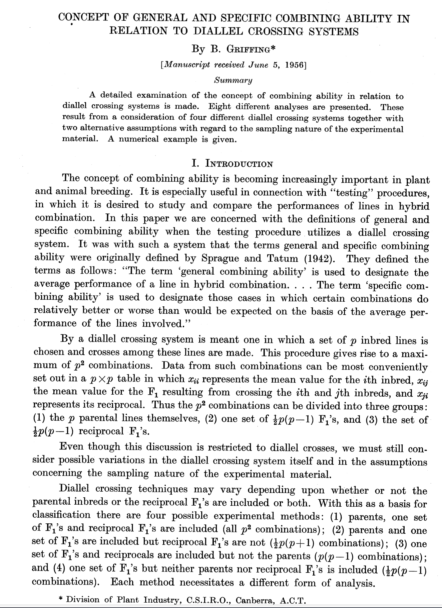
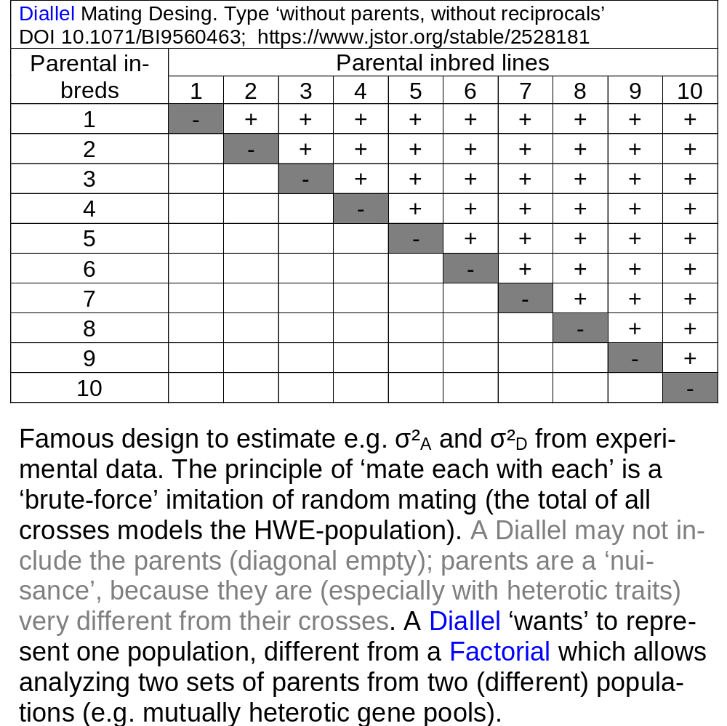
Diallel Analyses to experimentally estimate Genetic variance components.
See again UNPLAB-BrMeth_Ch-3[GCA I]
33

Slide 34
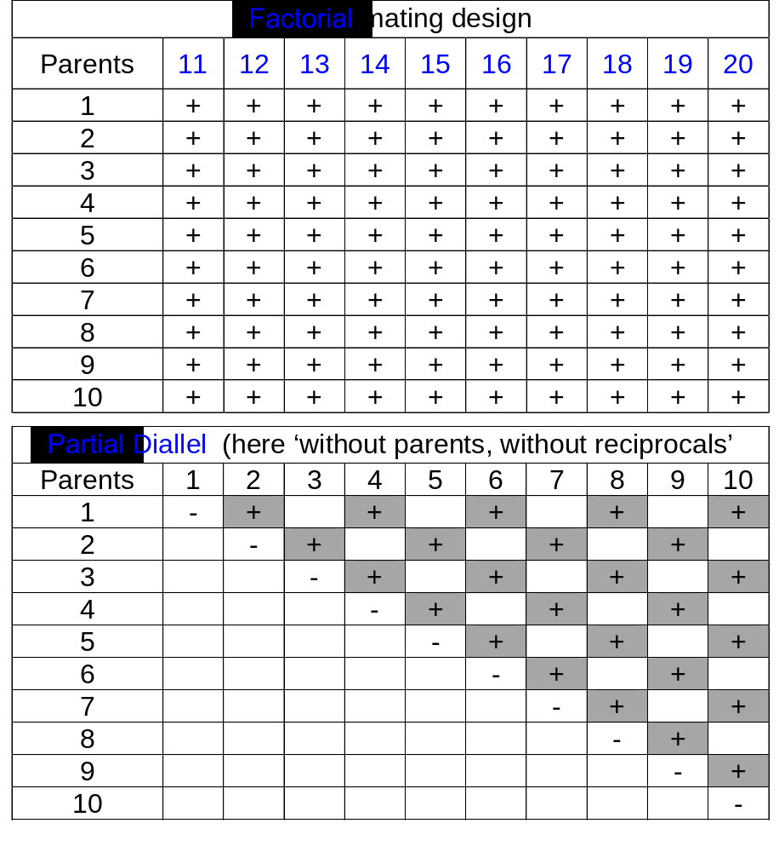
Factorial mating scheme and Partial Diallel mating scheme.
Factorial allows to analyse GCA and SCA between (mutually heterotic) germplasm pools, specifically focussing on hybrid breeding.
A Partial Diallel allows to ‚cover‘ a larger sample of parents (i.e. better representation of the reference population) with a still-limited number of crosses.
Mating schemes become fast prohibitively ‘large’
Parents | Number of crosses to conduct = number of offspring to evaluate
 | Diallel | Partial Diallel* | Factorial
6 | 15 | 9 | 9
10 | 45 | 25 | 25
100 | 4950 | 2500 | 2500
N | N(N-1)/2 | N²/4 | N²/4
*many further versions of partial Diallels exist
DOI 10.2307/2527989
34

Slide 35
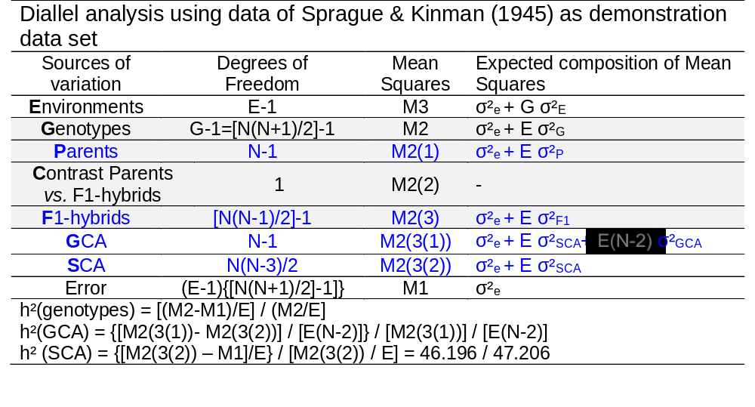
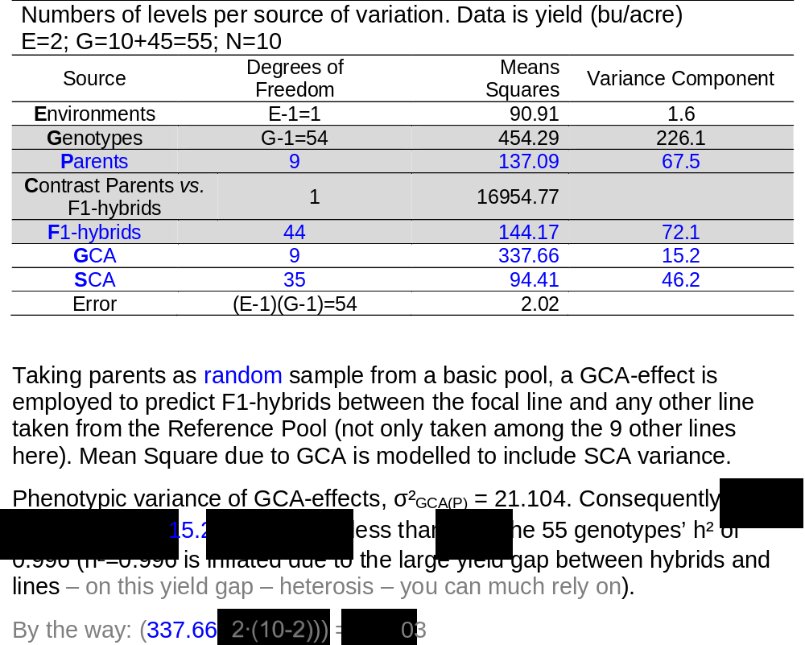
Estimate components of genetic variance from experimental data, employ them as parameters, ready-for-use to model and compare and optimize breeding approaches.
In case we accept the small number of 10 lines as representing our reference pool, then we deduce from this data:
σ²_{A} = 2 ∙15.2 = 31.4 (q/ha)²
σ²_{D} = 46.2 (q/ha)²
σ²_{G} = 77.6 (q/ha)²
Correspondingly (F_{P}=0) we find: r_{G}(HS) = 7.6/77.6 = 0.098; r_{G}(FS) = 0.345; r_{G}(PO) = 0.196
Correspondingly (F_{P}=1) we find: r_{G}(HS) = 15.2/77.6 = 0.196; r_{G}(FS) = 1.00; r_{G}(PO) = no algebra given here
35

Slide 36
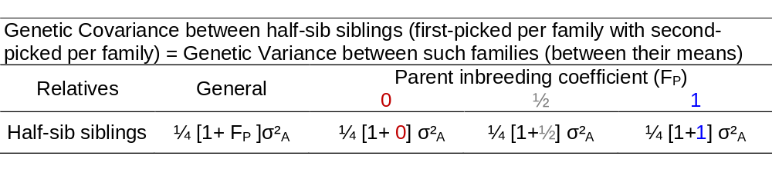
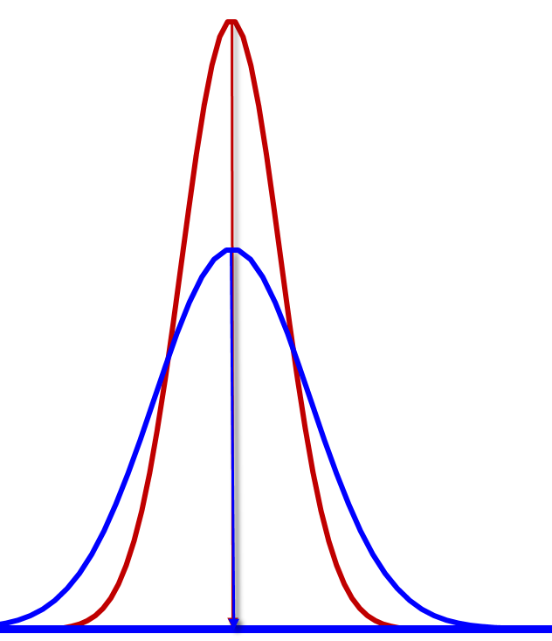
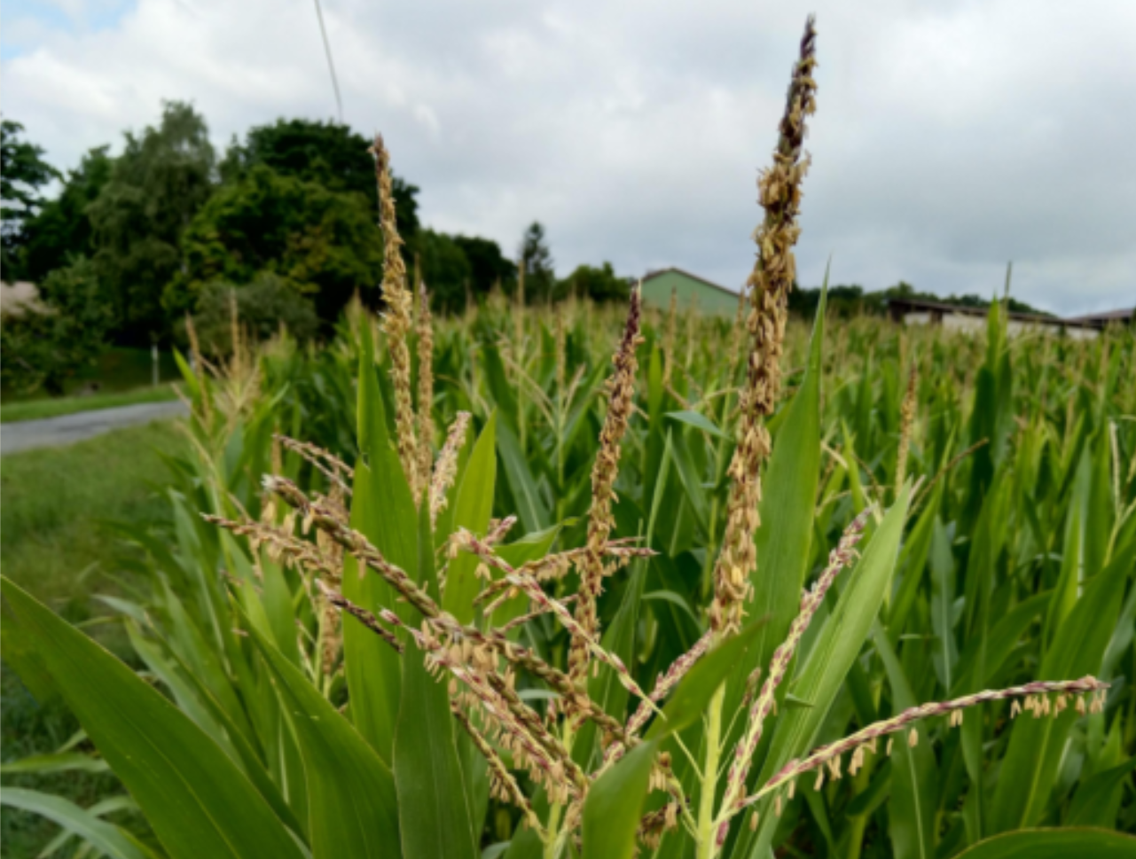
How well will Quantitative Genetic models predict what we find in Reality?
Here we inspect data on the influence of inbreeding status of candidates on variance between the Topcross-Offspring of those candidates.
Theory says: Genetic variance between HS-families is doubled, from ¼ σ²_{A} to ½ σ²_{A}, if we go from
● non-inbred candidates to ● fully inbred candidates instead as parents of such families
© WL
To meaningfully compare variances experimentally is hard to do, you need very large experiments. Yet, in some cases such data were created. See next two pages ;-)
Data to check is ISBN-13:‎ 978-0813815220
36

Slide 37
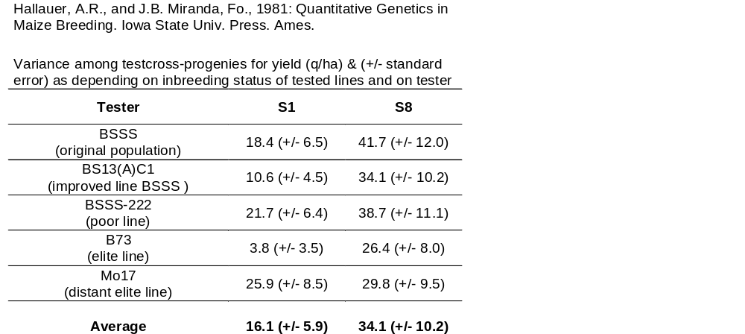
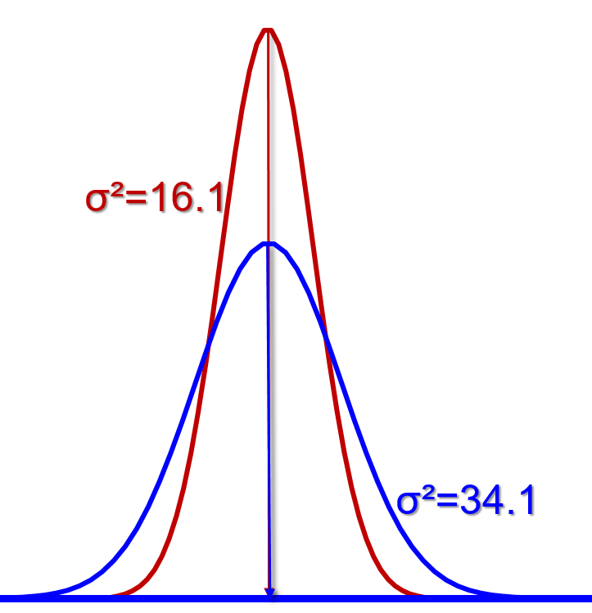
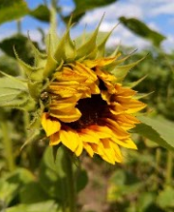
Maize breeders‘ jargon: They say ‚S0‘ to denote a non-inbred individual (taken from the HWE reference population), S0 to state ‚not-yet-selfed‘. They say S1 to say ‚once-selfed‘. Gregor Mendel says: „Their S0 plant is one individual of my F1 generation, and their S1 then is my F2, segregating 1:2:1 for all that was heterozygous in F1 aka S0)“.
Experimental data corroborate the theo-retical expectation that the variation bet-ween testcross-offspring is twice as high if the parents (tested lines) are ~ homozy-gous compared to when they are are S1*.
*
*next page
© WL

Slide 38
Variance among testcross-progenies for yield (q/ha) and (+/-) standard error, as depending on inbreeding status of tested entry and as depending on actual tester.
S1-line≙ S0-individual
S8-line
F~1
Double amount of variation among testcross-offspring if parents (tested lines) are homozygous than if not. What was crossed was (1) either S1* -lines aka F2-families; each as representative sample of the genes of its S0* (aka F1*) pa-rent; or (2) S8-lines (means F9-lines; it means selfed offs-pring each derived from a single F8 aka S7 individual). Hence:
Either (1) the gametic array of a panel of non-inbreds (F=0; fully segregating) entries was crossed to tester or (2) the gametic array of highly inbred (F≈1; non-segregating) entries. The variation in case of (1) is compared with case (2).
*
The experimental results show that variance among S8-testcrosses was, on average, ~twice as large as variation among S1 testcrosses. For the four related testers, estimates compare favourably with the expectation: “BS13(A)C1” (improved “BSSS”) and “B73” (good performance line) have less variability among their testcrosses than “BSSS” (original population) and less than “BSSS-222” (poor performing line). Smaller variance among testcrosses if testers are ‘good’, if they have a greater frequency of favourable (~dominant) alleles. Dominant alleles ‘hide’ recessive alleles of S0 and S8-candidates.
Estimates of variances come with large experimental error, so rather the average across several cases should be taken-home than individual case findings.

Slide 39
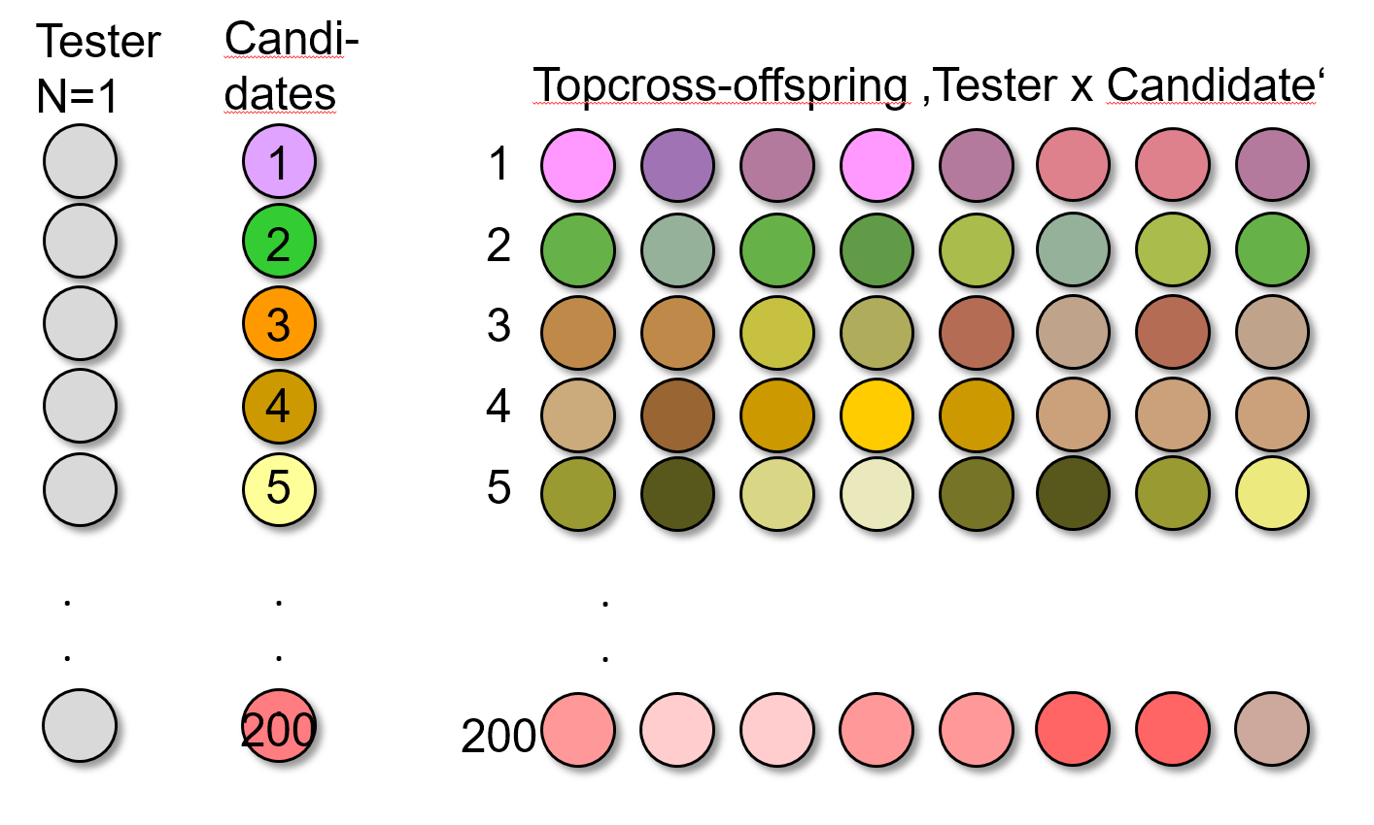
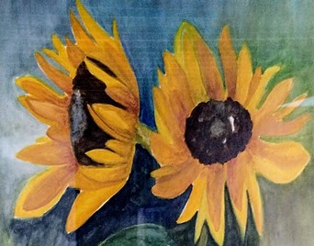
‘Application’: A sunflower-oriented example on ‘genetic variance between entries’
Population parameters of your trait: σ²_{A} = 32(dt/ha)², σ²_{D} = 24 (dt/ha)². Take sunflower grain yield in dt/ha as trait.
You manage a HWE-like population of sunflower. You want to select between experimental hybrids. For this purpose, you produce N=200 crosses, with 200 individuals (candidates) of the HWE-population as fathers (pollinators); employing one CMS (pollen-sterile) F1-hybrid as mother (Tester).
So: The 200 crosses have all this same mother, and each one has one specific, unique individual of the population as father. The entire lot is one half-sib family, yet our focus is on the variance between the 200 full-sib-families in this half-sib frame.
What is the genetic variance between these 200 crosses (Topcross-progenies; Topcross-offspring)?
© Gretl Cerny
Candidates are not field-tested ‚themselves‘, but via their Topcross-offspring (i.e., via CMS-Tester x Candidate-crosses)
39

Slide 40
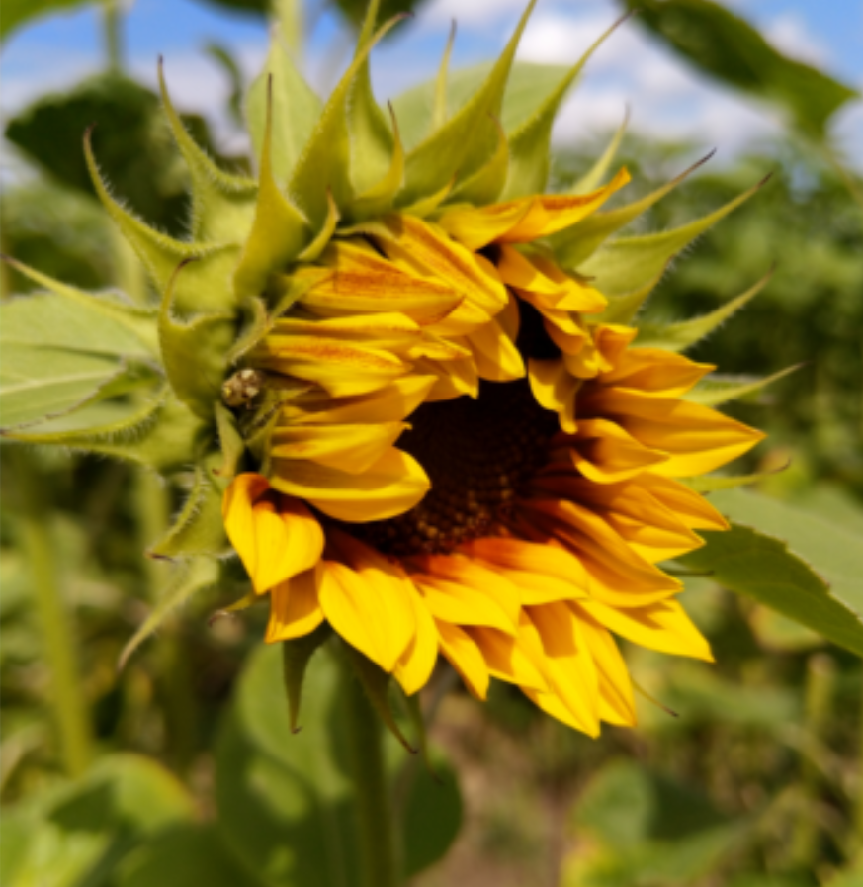
‘Application’: A sunflower-oriented example on ‘genetic variance between entries’
Population parameters of your trait: σ²_{A} = 32(dt/ha)², σ²_{D} = 24 (dt/ha)². Take sunflower grain yield in dt/ha as trait.
You manage a HWE-like population of sunflower. You want to select between experimental hybrids. For this purpose, you produce N=200 crosses, with 200 individuals (candidates) of the HWE-population as fathers (pollinators); employing one CMS (pollen-sterile) F1-hybrid as mother (Tester).
So: The 200 crosses have all this same mother, and each one has one specific, unique individual of the population as father. The entire lot is one half-sib family, yet our focus is on the variance between the 200 full-sib-families in this half-sib frame.
What is the genetic variance between these 200 crosses (Topcross-progenies)?
► It is σ²_{G} = ¼ σ²_{A} + ¼ σ²_{D}; meaning it is σ²_{G} = 14 (dt/ha)².
Why is it not σ²_{G} = ½ σ²_{A} + ¼ σ²_{D} (since this is the ‚wording‘ of the equation for
variance between full-sib-families; case of ‚no inbreeding‘ of the parents)?
Well, this equation supposes a set of female and a set of male parents. We have only a set of male parents, with N=1 female parent. This mother contributes no variation*. So: Only from one of the two parental ‘sides’ we receive genetic variation - therefore ¼ σ²_{A} instead of ½ σ²_{A}. Why then nevertheless ¼ σ²_{D}? A very fine-tuned question. It is because the Dominance Effects are (modelled to be) independent (uncorrelated) from the Breeding Values, thus the Dominance Effects of the crosses with just one mother are already a representative sample of ‘all’ Dominance Effects, hence with same variance as the Dominance Effects with ‘all’ mothers (n.b.: SCA-effects sum up to zero already within each column and row of a Diallel or Factorial mating scheme).
© WL
*This mother - as it is non-inbred - segregates! It is not homozygous! Why then does it not contribute variance?!
40

Slide 41
Increase the genetic variance by increasing the homogeneity of candidates.
*This mother segregates! Why then does it not contribute variance? It does, but it does not contribute to the variance between our entries! This is because the segregation of a parent creates the genetic variance among the siblings of the actual cross (aka variance ‘within cross’), it does not create the variation between the crosses (between the topcross-progenies). The variation that we seek, between the crosses, this variation is caused by the genetic differences between the parents (not the genetic differences between the gametes offered by any single parent).
What would the genetic variance between these 200 crosses be if we chose 200 random DH-lines (F_{P}=1) as fathers instead of 200 random HWE-individuals (F=0, same basic population), and one DH-line (F_{P}=1) as mother instead of the above-employed F1-hybrid?
►¡Now! Parents are fully inbred, they are homogeneous hence ‚all‘ variance is between their offspring!
From σ²_{FS} = ½ (1 + F_{P}) σ²_{A} + ¼ (1 + F_{P})² σ²_{D} we find σ²_{FS} = σ²_{A} + σ²_{D} .
Yet, again, only one ‚side‘ (the set of male candidates) has variation,
the tester is still only N=1 (tester is constant; mute when it comes to variance).
So, again, it is only ½ of this σ²_{A}
But, for the same reason as before, the full amount of σ²_{D} is included, so:
σ²_{G} = σ²_{FS} = ½ σ²_{A} + σ²_{D}; it would be σ²_{G} = 40 (dt/ha)².
We have two results:
Non-inbred parents: σ²_{G} = σ²_{FS} 14 (dt/ha)²
Homozygous (DH) parents: σ²_{G} = σ²_{FS} 40 (dt/ha)²
41

Slide 42
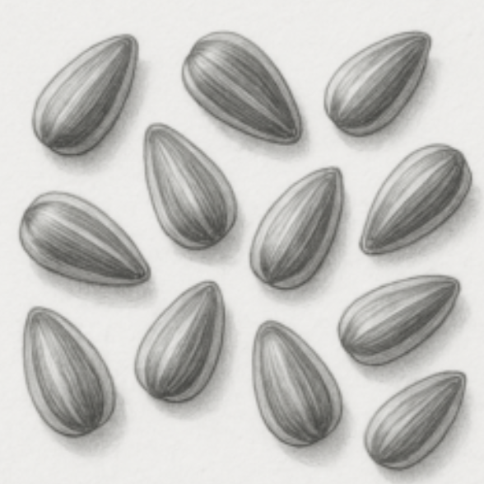
Increase the genetic variance by increasing variance between candidates.
We have two results:
Non-inbred parents: σ²_{G} = 14 (dt/ha)² ► Selection Differential* = 6.57 dt/ha
Homozygous (DH) parents: σ²_{G} = 40 (dt/ha)² ► Selection Differential* = 11.10 dt/ha
If we were to select the 10% best of the 200 crosses, what would be the expected superiority of this selected fraction over the general mean - in either case?
To take 10% best, we have to take all those who are above the point of truncation at 1.282 ∙ SD of the normal distribution from which we select (UNPLAB-h²_GxE_Ch-5[BreedersEquation]). These 20 best hybrids expectedly show an average superiority of 1.755 times the SD of that distribution.
Hence, the results are as indicated above in ►blue colour
Non-inbred parents: Naïvley* expected superiority would be 1.755 ∙ 14^{0.5} dt/ha = 6.57 dt/ha
Homozygous parents: Naïvley* expected superiority would be 1.755 ∙ 40^{0.5} dt/ha = 11.10 dt/ha
Based on this expectations, a breeding company may compare the financial and time investment to produce DH-lines (disadvantage) with the increased Selection Differential*.
More is said here: UNPLAB-BrMeth_Ch-3[GCA I]. If the entries and tester are pure
lines, then the crosses realize GCA plus the full amount of SCA-caused variance.
This might be nice if one of the crosses can be directly chosen as candidate cultivar,
yet might be unfortunate if data is used to estimate GCA and selection is an inter-
mittent step in Breeding (and is not to directly identify a hybrid as candidate cultivar).
Sunflower seeds
*Compare ‚Breeders Equation‘: Above, we not yet included shrinkage due to heritability h²<1.
42

Slide 43
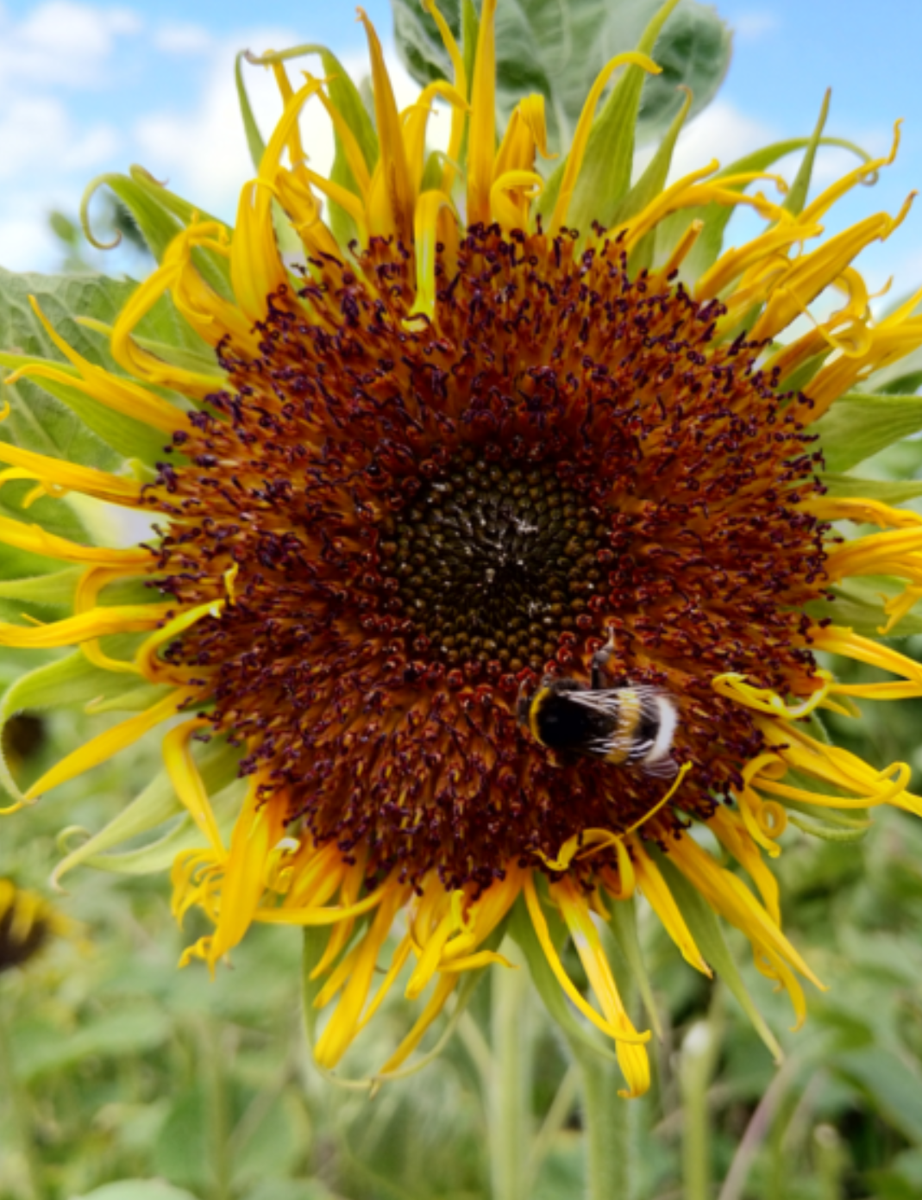
Impact of Variance on the Selection Differential when selecting the better 10%.
Non-inbred parents: 14 (dt/ha)² ► Mean of 10%best = 50.0 + 6.57 = 56.57dt/ha
Inbred parents: 40 (dt/ha)² ► Mean of 10% best = 50.0 + 11.10 = 61.10 dt/ha
The mean of the population is taken as 50 dt/ha. This mean is irrelevant for a comparison between the two cases.
© Wolfgang Link
Variance 14,
Variance 40,
Sel. Differential
6.57 dt/ha
Sel. Differential
11.10 dt/ha
43
30
35
40
45
50
55
60
65
70

Slide 44


Bavarian alpine landscape
Arrived :-)

Slide 45
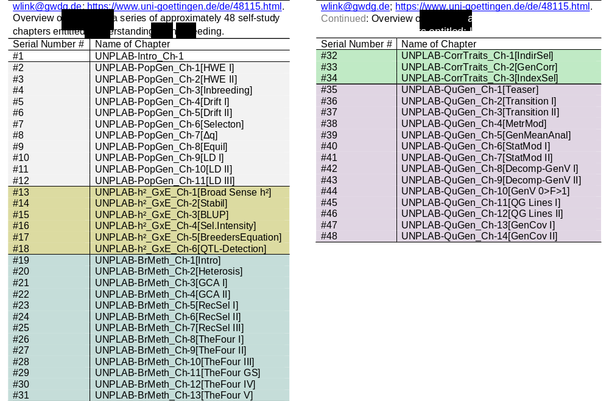
Please see here the – so far – 48 chapters listed. After the Intro Chapter you find chapters on: Population Genetics, on h² and GxE, on Breeding Method, on Correlated Traits, on Quantitative Genetics. Maybe that I add few chapters as ‘Miscellaneous’, we shall see. 16/01/2026 08:55 and 21/09/2026 11:34.
45

